Slide 1

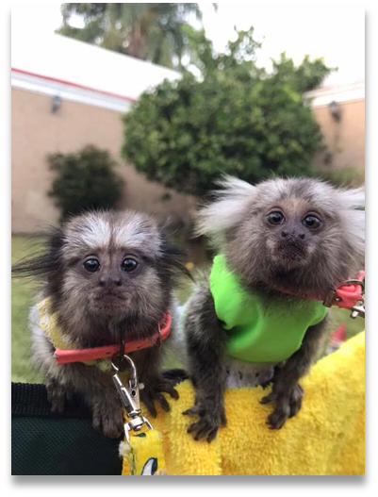
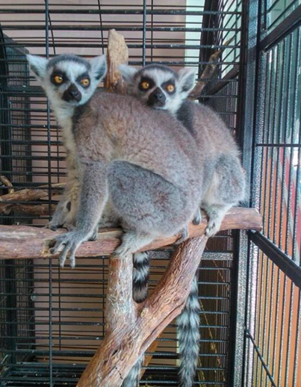
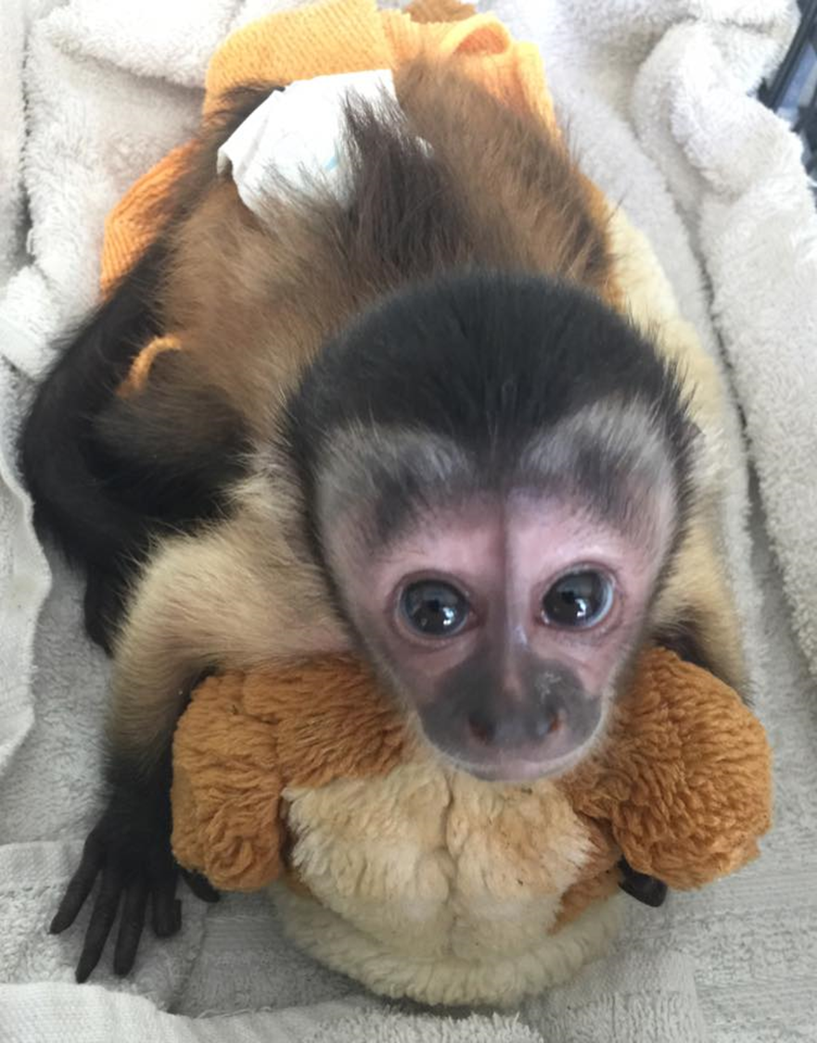

E-commerce of primates in the Americas
Presented by: Ericka Ceballos
CATCA Environmental and Wildlife Society

Slide 2
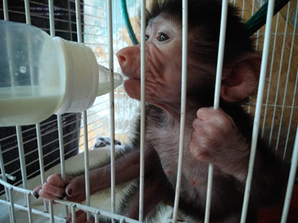
Introduction
History
Our e-commerce work
Our current work
Other monitorings

Slide 3
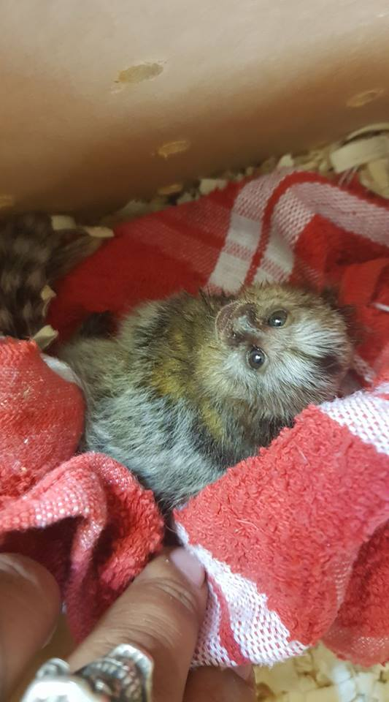
Objectives
Assess the e-commerce of primates and other
wildlife in Facebook
Assess the e-commerce of primates in the WWW
Evaluate the extend of this problem

Slide 4
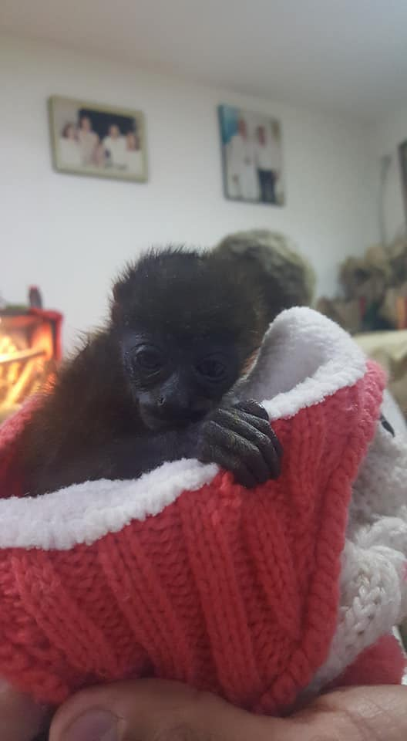
Methodology
Why Mexico?
Monitoring time frame
Challenges

Slide 5
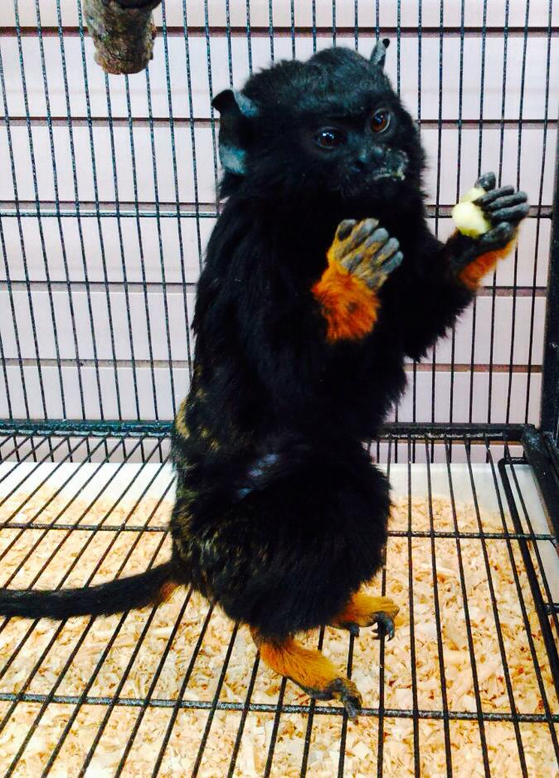
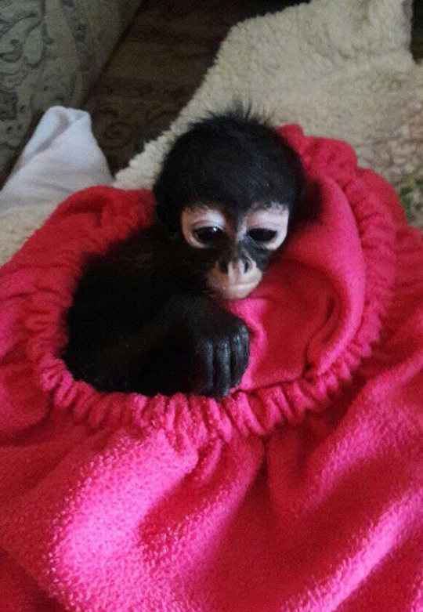
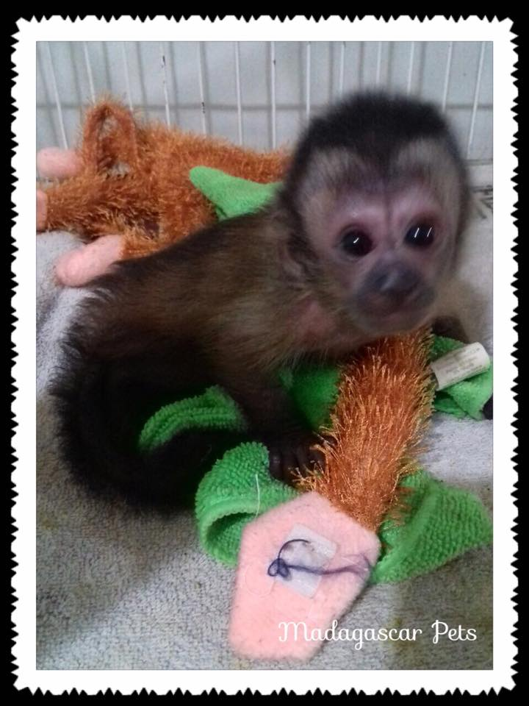
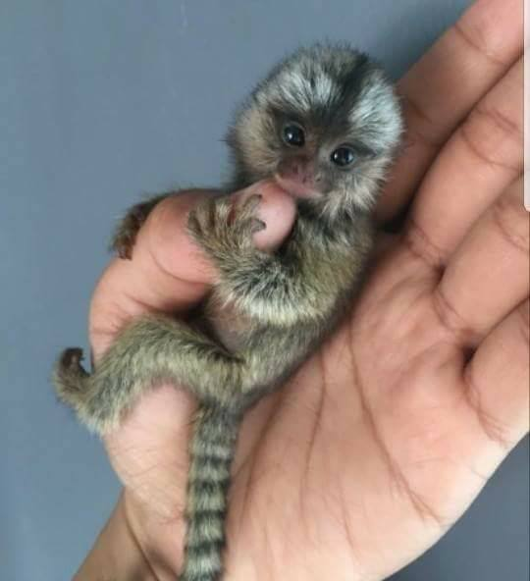
Facebook Results

Slide 6
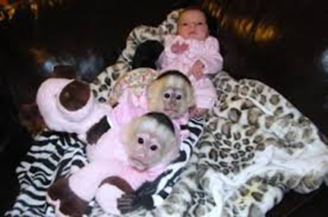
Family | Species | CITES App. | Comments on CITES classification | Offers number | Min. # animals
Atelidae | mantled howler monkey Alouatta palliata | I |  | 1 | 2
 | Central American black howler monkey Alouatta pigra | I |  | 1 | 1
 | brown headed spider monkey Ateles fusciceps | II |  | 2 | 3
 | Central American spider monkey Ateles geoffroyi | II |  | 2 | 4
Callitrichidae | black crowned dwarf marmoset Callibella humilis | II |  | 9 | 24
 | buffy tufted ear marmoset Callithrix aurita | I |  | 6 | 26
 | buffy headed marmoset Callithrix flaviceps | I |  | 4 | 11
 | Geoffroy's marmoset Callithrix geoffroyi | II |  | 8 | 20
 | common marmoset Callithrix jacchus | II |  | 34 | 117
 | Wied's black tufted ear marmoset Callithrix kuhlii | II |  | 6 | 13
 | black tufted marmoset Callithrix penicillata | II |  | 18 | 39
 | pygmy marmoset Cebuella pygmaea | II |  | 13 | 45
 | black headed marmoset Mico nigriceps | II |  | 1 | 1
 | Geoffroy's tamarin Saguinus geoffroyi | I |  | 1 | 3
 | golden handed tamarin Saguinus midas | II |  | 1 | 3
 | Spix's moustached tamarin Saguinus mystax | II |  | 4 | 9
 | black handed tamarin Saguinus niger | II |  | 1 | 3
Table I.-Species of primates
found in Facebook Mexico

Slide 7
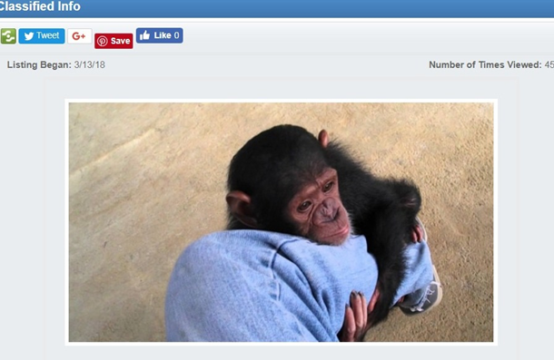

black mantled tamarin Saguinus nigricollis | II |  | 1 | 1
cotton top tamarin Saguinus oedipus | I |  | 17 | 33
Humboldt's white fronted capuchin Cebus albifrons | II |  | 4 | 10
Colombian white-faced capuchin Cebus capucinus | II |  | 5 | 16
shock headed capuchin Cebus cuscinus | II | as Cebus albifrons cuscinus | 1 | 1
Panamanian white-faced capuchin Cebus imitator | II | as Cebus capucinus imitator | 14 | 82
Kaapori capuchin Cebus kaapori | II |  | 4 | 9
Sierra de Perija white fronted capuchin Cebus leucocephalus | II | as Cebus albifrons leucocephalus | 1 | 1
wedge capped capuchin Cebus olivaceus | II |  | 2 | 4
Peruvian white fronted capuchin Cebus yuracus | II | as Cebus albifrons yuracus | 1 | 3
tufted capuchin Sapajus apella | II | as Cebus apella | 16 | 38
hooded capuchin Sapajus cay | II | as Cebus libidinosus paraguayanus | 1 | 2
black striped capuchin Sapajus libidinosus | II | as Cebus libidinosus libidinosus | 6 | 16
black capuchin Sapajus nigritus | II | as Cebus nigritus | 11 | 23
crested capuchin Sapajus robustus | II | as Cebus apella robustus and recently as Cebus nigritus robustus | 5 | 10
Humboldt's squirrel monkey Saimiri cassiquiarensis | II | as Saimiri sciureus cassiquiarensis | 7 | 47
Collins' squirrel monkey Saimiri collinsi | II |  | 5 | 12
Guianan squirrel monkey Saimiri sciureus | II |  | 11 | 28

Slide 8
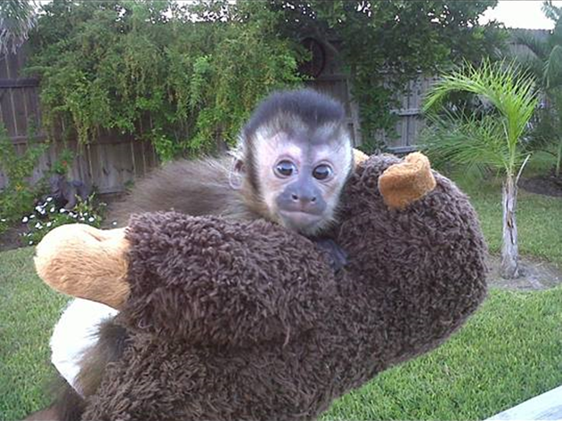
bare eared squirrel monkey Saimiri ustus | II |  | 11 | 26
Cercopithecidae | vervet monkey Chlorocebus pygerythrus | II |  | 2 | 2
 | patas monkey Erythrocebus patas | II |  | 2 | 2
 | long tailed macaque Macaca fascicularis | II |  | 1 | 2
 | rhesus macaque Macaca mulatta | II |  | 1 | 1
 | Mandrill Mandrillus sphinx | I |  | 1 | 1
 | olive baboon Papio Anubis | II |  | 10 | 31
 | hamadryas baboon Papio hamadryas | II |  | 8 | 24
 | Kinda baboon Papio kindae | II | as Papio cynocephalus kindae | 3 | 7
Hominidae | Chimpanzee Pan troglodytes | I |  | 5 | 7
Pitheciidae | black fronted titi monkey Callicebus nigrifrons | II |  | 1 | 2
 | brown titi monkey Plecturocebus brunneus | II | as Callicebus brunneus | 1 | 2
 | ashy back titi monkey Plecturocebus cinerascens | II | as Callicebus cinerascens | 3 | 3
 | Toppin’s titi Plecturocebus toppini | II | as Callicebus cupreus | 1 | 1
Lemuridae | ring tailed lemur Lemur catta | I |  | 36 | 169
 | black-and-white ruffed lemur Varecia variegata | II |  | 1 | 1
TOTAL: |  |  |  | 324 | 965

Slide 9
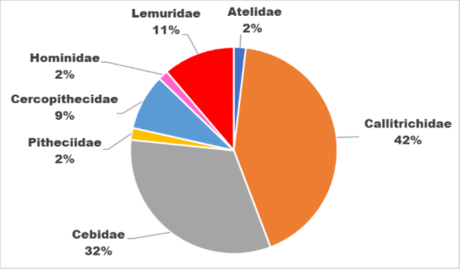
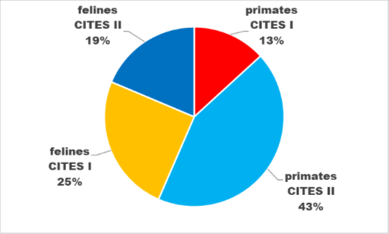
Fig. 1. Share of number of offers of primates from different families for sale in the Mexican Facebook
Fig. 2. Share of number of offers of primates and felines species from different CITES Appendices, detected in Mexican Facebook profiles

Slide 10
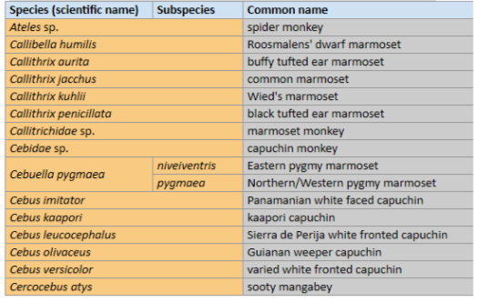
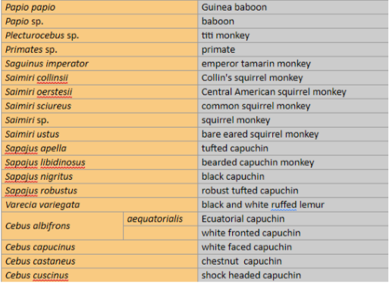
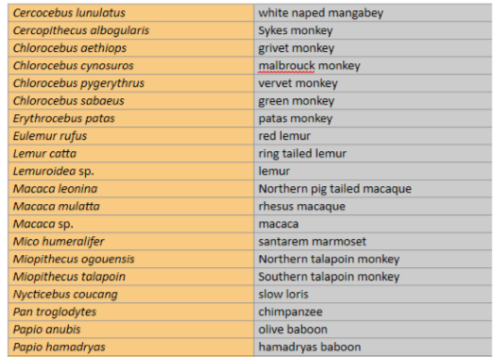
albifrons
Table 2- Primates: at least 46 species and in the case of Cebuella pygmaea– 2 subspecies

Slide 11
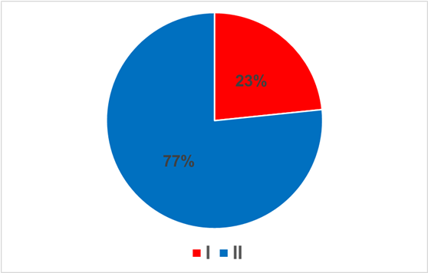
FB profile name | Number of offers
Madagascar pets | 22
Sky Reptiles Mexico | 15
Grupo Sky Reptiles Mexico | 14
Zooper pets | 13
Puebla wid life | 13
Venta animales exoticos CD Juarez | 13
Animales Exoticos Sol Y Luna | 11
Exotik pets and more mty | 11
Chilo Chopper venta de animales exoticos | 11
Obsidian reptiles | 10
Finca Guadalupe Criadero de Monos | 10
GEM Grupo Exotic MX | 9
Aves de Canto Chilpancingo | 9
Criadero Shambala | 9
Animales exoticos | 8
Venta de Animales Exoticos Cd. Juarez | 8
Compra y venta de animales exóticos en Guadalajara, Jalisco | 8
Repstyle. Exotic Animals | 7
Comercializacion de fauna exotica legal en Mexico | 7
Santa Fe wild life | 7
Compra y venta de animales exoticos | 6
Animales Exoticos MX | 6
Animales Exóticos Luna | 6
Pimvs Moloch | 6
Merida wild life | 5
Exóticos Chihuahua | 5
Exoticox Matamoros | 5
Mascotas exoticas de Mexico | 5
Fig. 1.- Share of offers of live primates from different CITES Appendices offered for sale on Mexican Facebook profiles
Table 3.- Mexican Facebook pages with the highest number of primate offers for sale

Slide 12
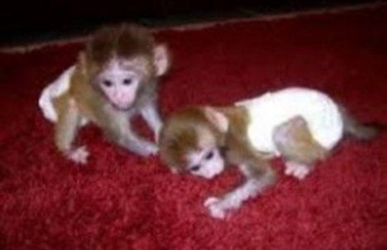
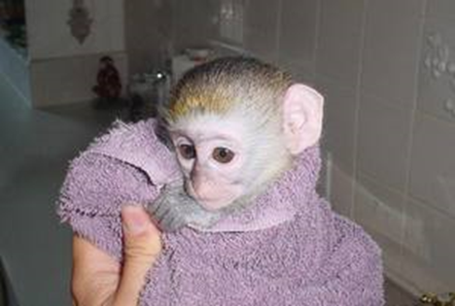
Table 4.- Number and percentage of offers of primates, felids and other CITES protected fauna species published in Facebook from different states of Mexico

Slide 13
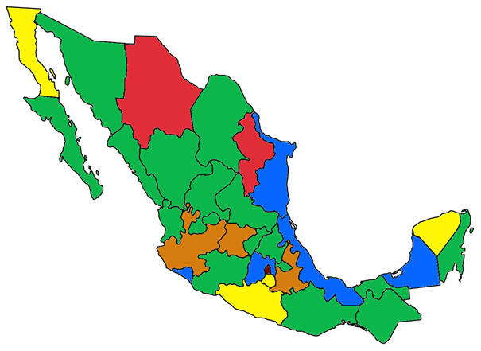
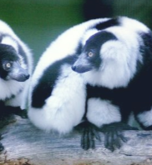
Fig. 1. The relative frequency of offers of primate species for sale, offered on Facebook from different Mexico states

Slide 14
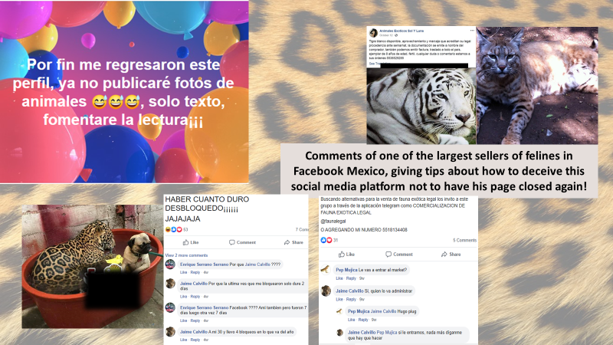

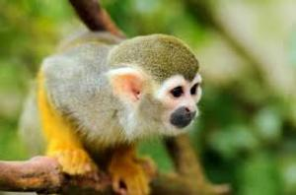
Comments of one of the largest primate sellers in Facebook Mexico, giving tips about how to deceive this social media platform, to not have his page closed again.

Slide 15
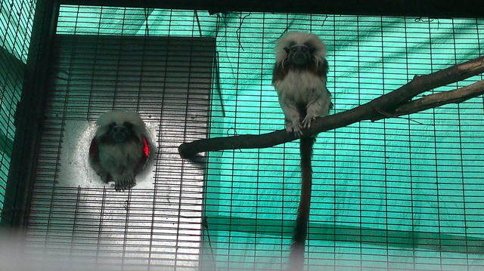
Mexican WWW Results

Slide 16
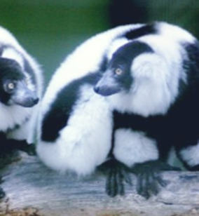
Species (scientific name) | Live animals offered for sale
 | Number of offers | Minimal number of offered specimens
Ateles sp. | 23 | 79
Callibella humilis | 4 | 7
Callithrix aurita | 2 | 3
Callithrix jacchus | 51 | 104
Callithrix kuhlii | 3 | 7
Callithrix penicillata | 4 | 9
Callitrichidae sp. | 21 | 63
Cebidae sp. | 25 | 63
Cebuella pygmaea | 38 | 82
Cebus imitator | 13 | 25
Cebus kaapori | 2 | 4
Cebus leucocephalus | 4 | 6
Cebus olivaceus | 11 | 35
Cebus versicolor | 9 | 13
Cercocebus atys | 2 | 4
Cercocebus lunulatus | 1 | 1
Cercopithecus albogularis | 1 | 3
Chlorocebus aethiops | 19 | 60
Chlorocebus cynosuros | 2 | 10
Chlorocebus pygerythrus | 38 | 82
Chlorocebus sabaeus | 33 | 93
Erythrocebus patas | 7 | 21
Eulemur rufus | 1 | 3
Lemur catta | 22 | 80
Lemuroidea sp. | 1 | 5
Macaca leonina | 1 | 2
Macaca mulatta | 8 | 19
Macaca sp. | 3 | 11
Table 1- Primates species found in the Mexican WWW. Only offers of live
animals were found. On 544 offers
We found at least 1425 animals offered

Slide 17
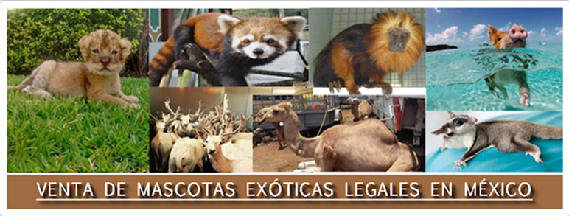
Mico humeralifer | 1 | 1
Miopithecus ogouensis | 9 | 17
Miopithecus talapoin | 15 | 33
Nycticebus coucang | 2 | 4
Pan troglodytes | 45 | 114
Papio anubis | 1 | 5
Papio hamadryas | 1 | 10
Papio papio | 1 | 5
Papio sp. | 1 | 5
Plecturocebus sp. | 9 | 27
Primates sp. | 3 | 22
Saguinus imperator | 2 | 5
Saimiri collinsii | 4 | 4
Saimiri oerstesii | 1 | 2
Saimiri sciureus | 7 | 20
Saimiri sp. | 23 | 89
Saimiri ustus | 4 | 13
Sapajus apella | 10 | 28
Sapajus libidinosus | 1 | 2
Sapajus nigritus | 4 | 9
Sapajus robustus | 3 | 8
Varecia variegata | 1 | 3
Cebus albifrons | 12 | 32
Cebus capucinus | 25 | 62
Cebus castaneus | 6 | 6
Cebus cuscinus | 4 | 5
TOTAL | 544 | 1425

Slide 18

Service | Number of taxa offered | Number of offers found | Minimal number of specimens
animales-exoticos.infored.com.mx | 1 | 1 | 5
blidoo.com.mx | 10 | 30 | 60
ciudadanuncios.com.mx | 41 | 354 | 886
elarcca.com | 4 | 4 | 20
evisos.com.mx | 4 | 7 | 13
exoticlife.mex.tl | 6 | 6 | 30
global-free-classified-ads.com | 10 | 19 | 51
mercadolibre.com.mx | 1 | 1 | 1
www.anunciosgratis.com.mx | 6 | 6 | 14
www.anunciosgratis.mx | 7 | 7 | 14
www.avisolisto.com.mx | 7 | 11 | 21
www.clasf.mx | 6 | 15 | 33
www.classifiedspet.info | 1 | 1 | 6
www.iclasificados.com.mx | 10 | 20 | 68
www.metabuscador.com.mx | 5 | 6 | 12
www.Minizoo.com.mx | 8 | 9 | 45
www.mundoanimal.mx | 3 | 3 | 30
www.mxanuncios.com | 2 | 3 | 6
www.oportuna.com | 5 | 8 | 8
www.planetamexico.com.mx | 11 | 23 | 70
www.uclasificados.com.mx | 6 | 6 | 12
www.vendetodo.com.mx | 1 | 1 | 4
xochimilco.wired.com.mx | 3 | 3 | 16
TOTAL |  | 544 | 1425
Table 2- Services with the most
offered Taxa in the Mexican WWW

Slide 19
State | Number of offers found | Minimal # of offered specimens
Aguascalientes | 11 | 19
Baja California | 21 | 65
Baja California Norte | 29 | 57
Baja California Sur | 4 | 7
Campeche | 10 | 20
Chiapas | 5 | 9
Chihuahua | 9 | 17
Coahuila | 11 | 18
Colima | 6 | 10
DF | 94 | 227
Durango | 14 | 33
Edo Mexico | 29 | 89
Guadalajara | 4 | 9
Guanajuato | 15 | 40
Guerrero | 7 | 10
Hidalgo | 6 | 10
Jalisco | 56 | 149
Michoacan | 5 | 9
Monterrey | 6 | 11
Morelos | 1 | 3
Nayarit | 3 | 6
Nuevo Leon | 44 | 146
Oaxaca | 8 | 15
Puebla | 23 | 64
Queretaro | 6 | 35
Quintana Roo | 5 | 18
San Luis Potosi | 11 | 23
Sinaloa | 8 | 16
Sonora | 2 | 8
Tabasco | 5 | 9
Tamaulipas | 10 | 44
Tlaxcala | 23 | 62
Veracruz | 8 | 32
Yucatan | 4 | 7
Zacatecas | 11 | 26
UNKNOWN | 30 | 102
TOTAL | 544 | 1425
Table 3- Primate offers found in the Mexican WWW

Slide 20
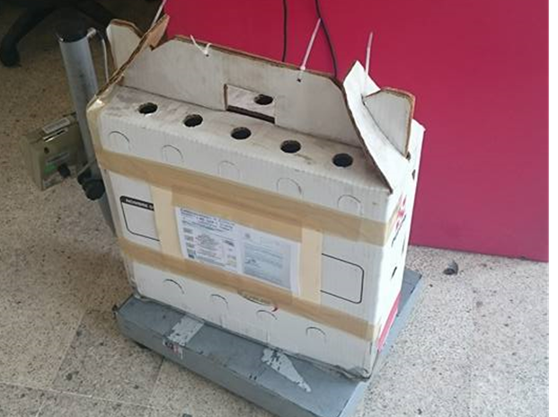
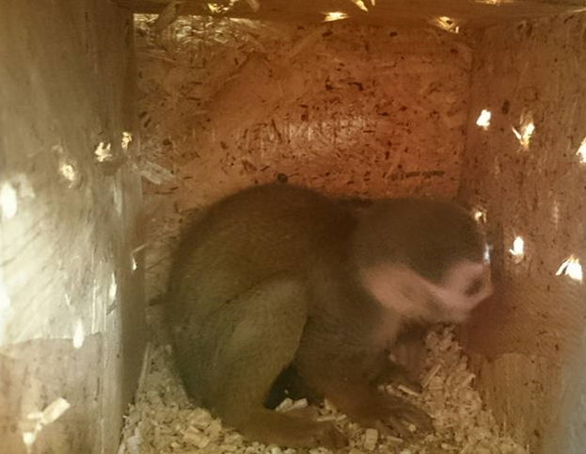
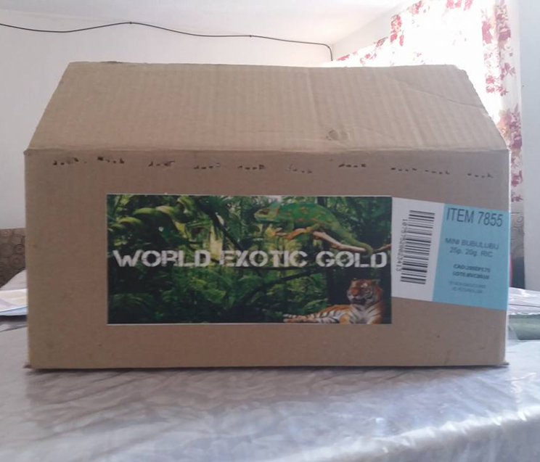
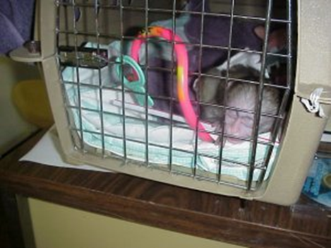
Shipping

Slide 21
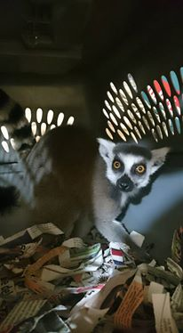
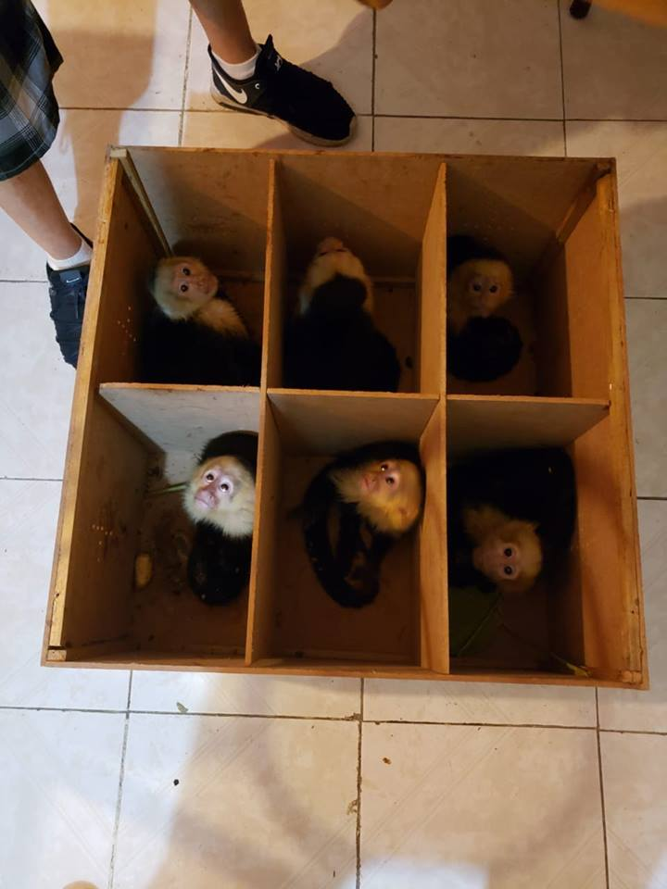
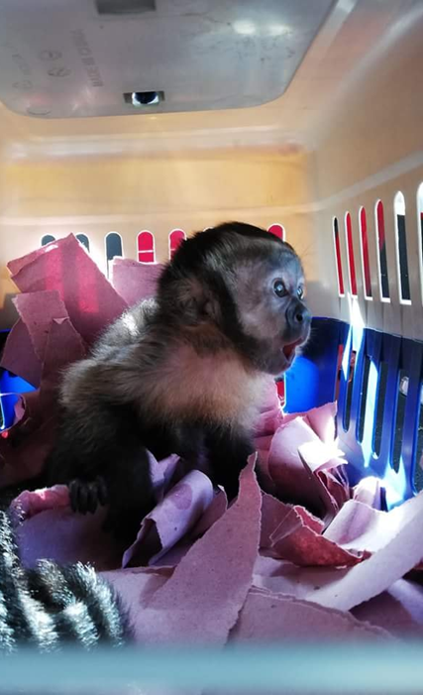

Slide 22
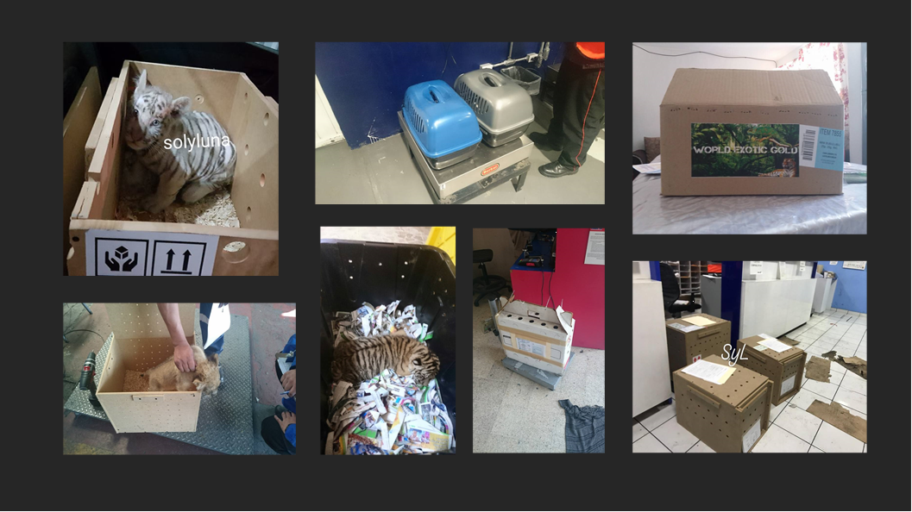

Slide 23
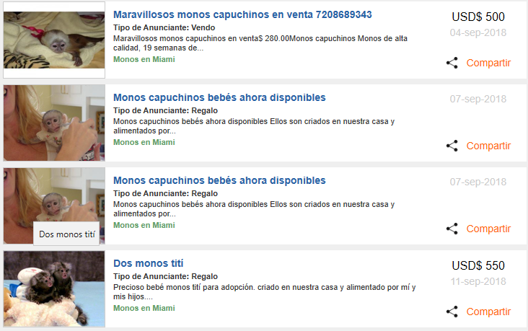
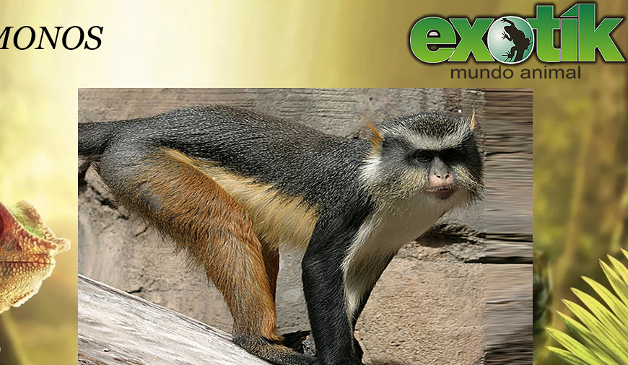
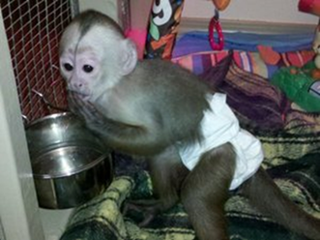
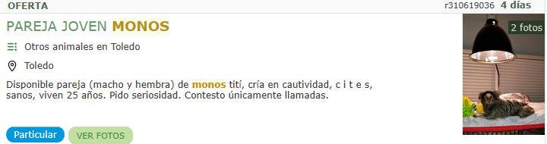
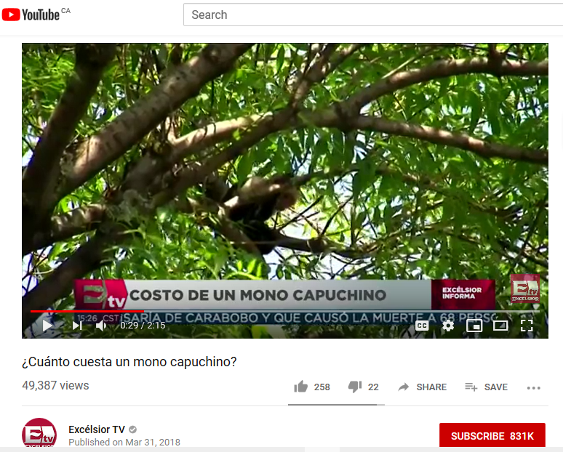
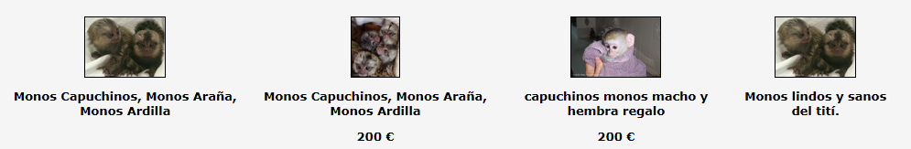
Other countries

Slide 24
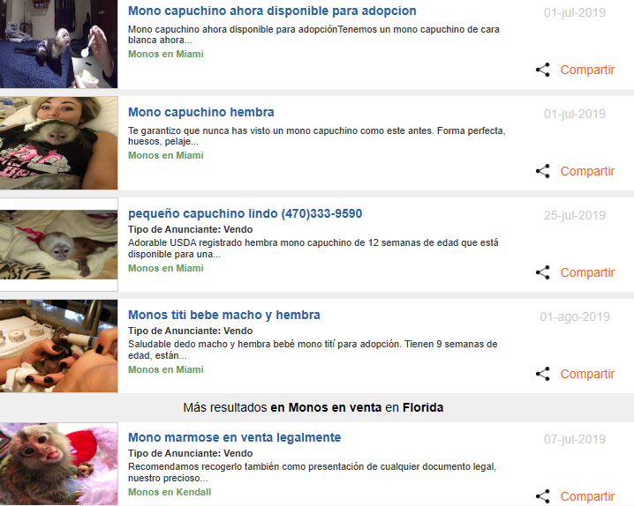
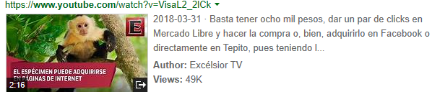
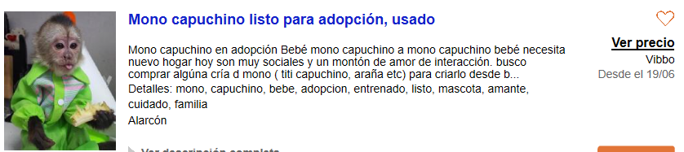
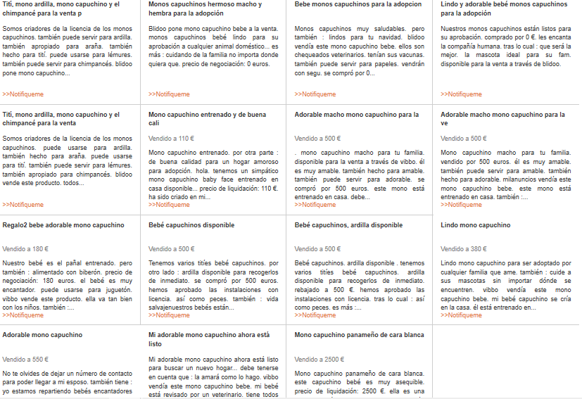


Slide 25
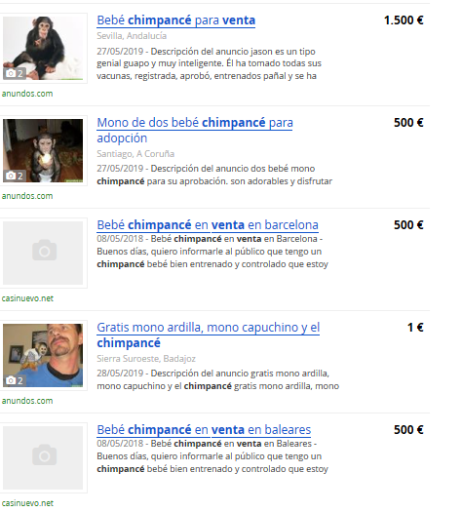
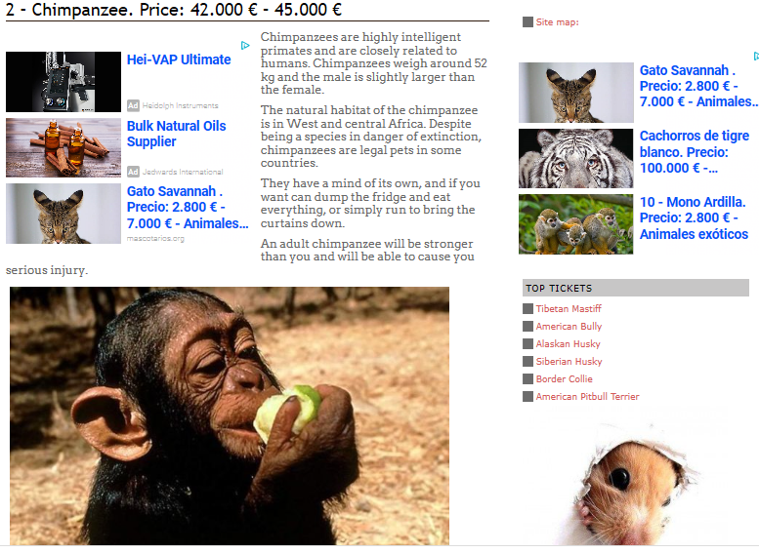
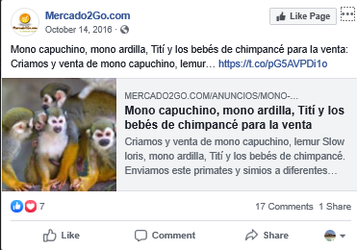
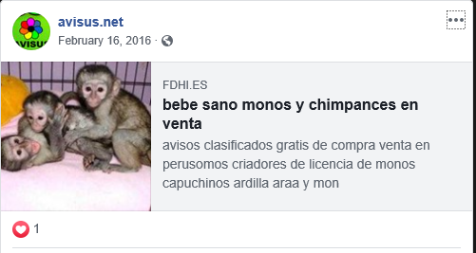

Slide 26






Slide 27


Slide 28
Recommendations
The legal and illegal e-commerce of primates is quite extended in Mexico and over the Americas, hence the need of the countries authorities to monitor their internet
This problem occurs all over the world, with primates and other endangered fauna species, so all countries should be urged to implement daily monitorings of their internet to reduce it
Airlines, bus companies and shipping companies should ban the transportation of primates and other endangered live animals
Most important, allowing the legal trade of primates (or any other endangered wild fauna), makes it very easy for the illegal sellers to sell specimens, hide their identities in the internet and pretend to be legal. People don’t ask, just buys!
A wide local, state/province and federal education is much needed worldwide, about exotic animals NOT been pets
Jail for the illegal breeders and large fines to buyers to discourage and to set an example

Slide 29

Conclusions
The extend of the e-commerce of primates in social media and the WWW in Mexico is quite large and alarming
This type of e-commerce is also present all over the Americas in social platforms as Facebook and the WWW
In Mexico’s case, to have legal breeders of primates and other exotic wildlife, has opened a big opportunity for all illegal breeders, as there is no control. If one person can afford to buy (or steal from the wild) primates or any other exotic animal species, they can easily breed them from their own home for profit, providing the minimum care and not taking in consideration the basic needs required for these species
The welfare of primates and other American or foreign wildlife fauna species found is very poor. In the case of amphibians, arthropods, birds and reptiles their breeding and living conditions often are overcrowded, filthy and in unproper environments
Until when there is a wide educational campaign to make people understand that primates and other wild fauna species are NOT suitable as pets, the problem will continue. From 2008 to date, there is more awareness in Latin America about it, but not enough to fight this growing problem
A lot is needed in the federal, state/provincial and municipality level sections, to end this trade
The enforcement of the law and stronger laws are required to tackle this problem effectively

Slide 30






Do not let this e-commerce trade continue…

Slide 31

Thank you so much for your kind attention

Slide 32




Our work for this presentation was made
with the support of:

Slide 33



Check for more interesting findings and information of our investigation,
in our new report, at http://www.catca-ews.org/wordpress/e-trade/
Do you want us to teach your webmasters or for us to formally monitor your country WWW? Contact Ericka Ceballos & team at catcaews@gmail.com

