Slide 1
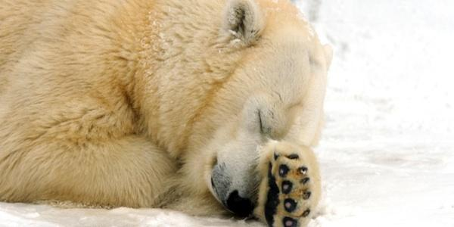
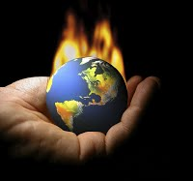
POLAR BEARS AND CLIMATE CHANGE
CATCA Environmental and Wildlife Society

Slide 2
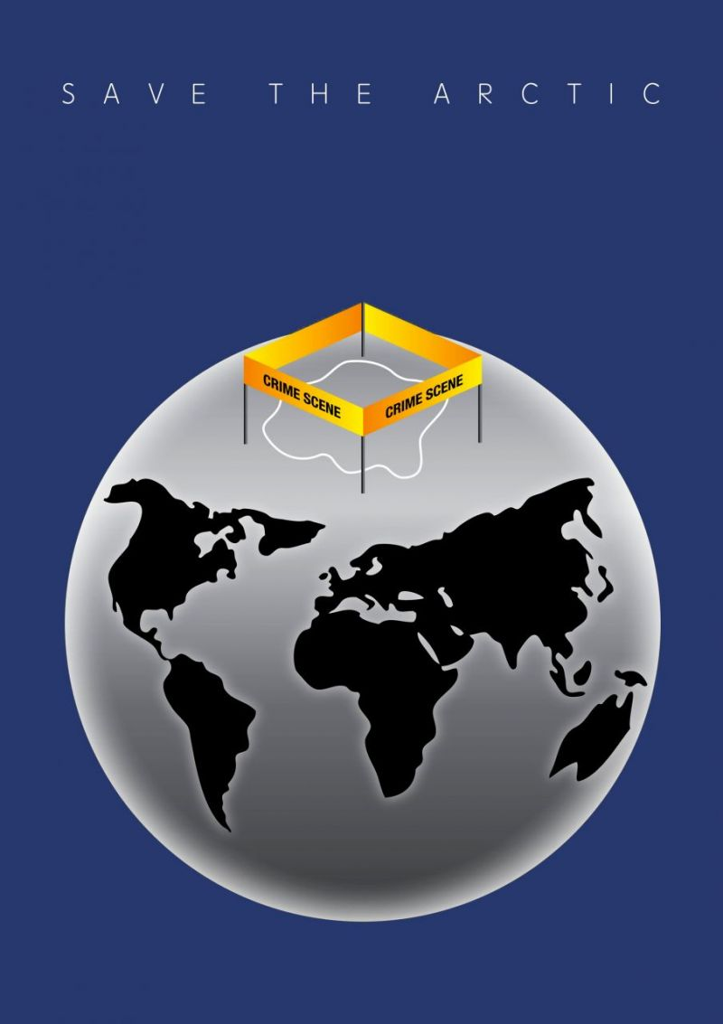
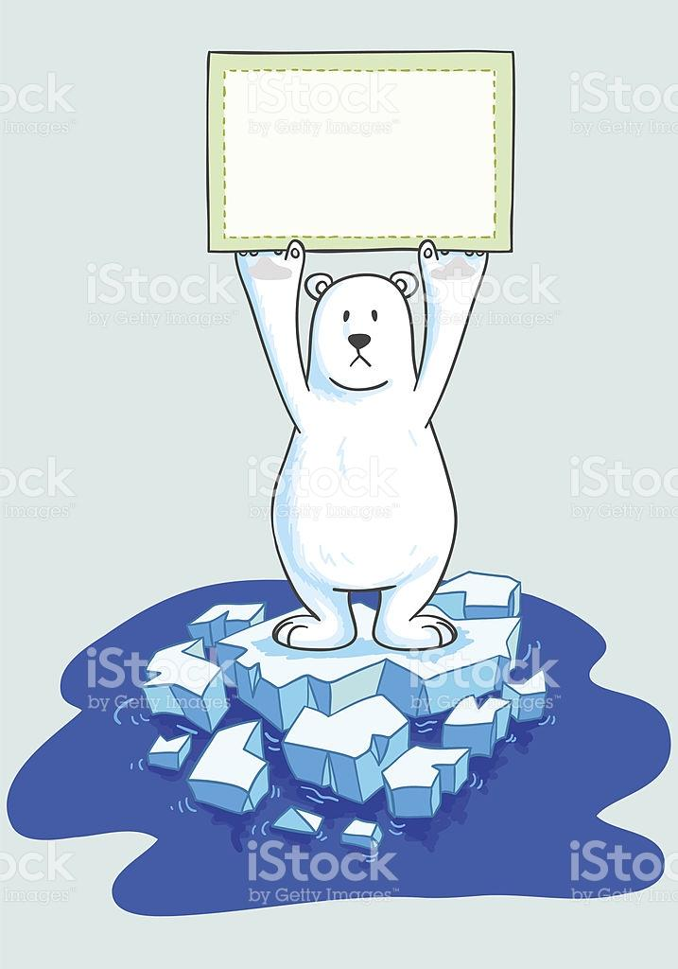
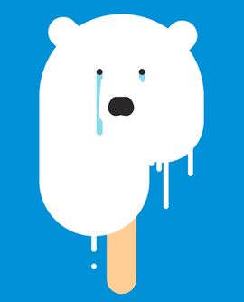
Part I
The Arctic, Polar bears and how
global warming is affecting them
WAKE UP HUMANS!

Slide 3
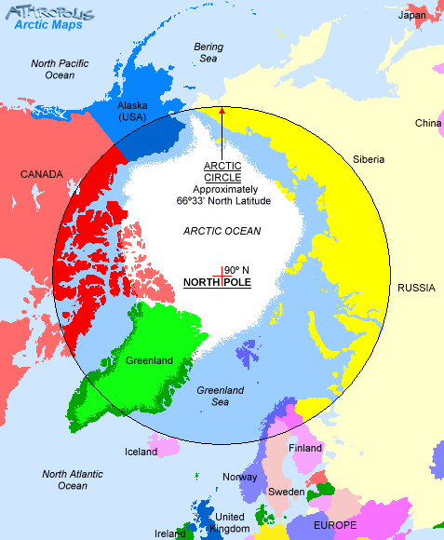
The Arctic
The Arctic has over 14 million square kilometers of land, water and ice
It encompasses all land and sea north of the 66th Parallel
The Arctic Circle shares a border with 8 nations: Canada, Finland, Greenland, Iceland, Norway, Russia, Sweden and the US
Under international law, the high seas including the North Pole and the region of the Arctic Ocean surrounding it, are not owned by any country
- The Arctic consists of land, internal waters, territorial seas exclusive Economic zones (EEZs) and high seas. All land, internal waters, territorial seas and EEZs in the Arctic are under the jurisdiction of one of the five Arctic coastal states:Canada, Norway, Russia, Denmark (via Greenland) and the US.
International law regulates this area as with other portions of the Earth

Slide 4
A global warming report states that the continued burning of fossil fuels will lead to the loss of all Arctic ice within the next 50 years

Slide 5
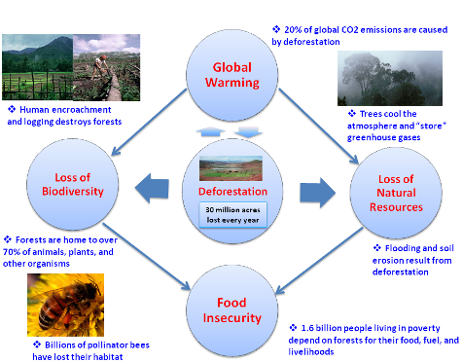
The Arctic habitat is suffering as a result of the changing environment caused by global warming and is affected throughout all the trophic levels of its delicately balanced food web.

Slide 6
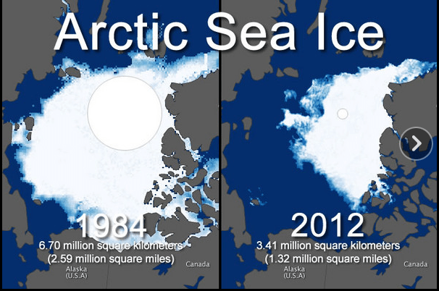
We are losing the battle to save the Arctic
The arctic habitat that these polar bears inhabit has decreased by nearly 20% since 1980 and this decrease is set to accelerate in the future. It is predicted that if we do not get a hold of our CO2 emissions by 2060, the ice caps will be committed to melting. That means no habitat for the polar bears at all.
https://lucyhagger.wordpress.com/2013/03/08/losing-the-polar-bear-battle/

Slide 7
In the high Arctic, the base of many food chains consists of ice algae rather than phytoplankton. Numerous species of copepod use the under ice areas of sea water to reproduce, and they feed on the ice algae before the phytoplankton bloom.
The loss of this ecosystem, through the reduction in ice would cause major knock on effects to productivity, nutrient supply and trophic response higher up the food chain; such as changes in the density and distribution of numerous fish species.

Slide 8
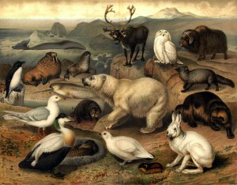
The Arctic is home to numerous species of wild animals which have adapted to live in this very harsh conditions. According to the Arctic Biodversity Trends 2010 report, all types of habitats—sea ice, tundra, permafrost peatlands, ponds and lakes formed by melting permafrost—are changing and impacting biodiversity. There is less ice for species that depend on sea ice for hunting, breeding or sheltering their young, such as polar bears, walruses, and certain kinds of seals. As the permafrost thaws, the Arctic tundra is gradually becoming shrubbier. Shrubs trap snow in winter, which insulates soil and keeps it warmer, spurring the decomposition that returns more carbon into the atmosphere. The loss of grasses and mosses on the tundra may impact the caribou and reindeer populations. And the changing vegetation makes the tundra more vulnerable to wild fires. In addition, the earlier melting of ice, flowering and emergence of insects could cause mismatches between access to food and the timing of reproduction for many species whose life cycles are synchronized with the coming of spring and summer.
http://blogs.ei.columbia.edu/2012/12/06/how-the-warming-arctic-affects-us-all/

Slide 9
Polar Bear Facts
The polar bear (Ursus maritimus) is a carnivorous bear, whose native range lies largely within the Arctic Circle, encompassing the Arctic Ocean, its surrounding seas and surrounding land masses.
A polar bear's home range can be enormous—far greater than any other species of bear. The size of a polar bear's range depends on two main factors: habitat quality and availability of seal prey.

Slide 10
A boar (adult male) weighs around 350–700 kg (772–1,543 lb), while a sow (adult female) is about half that size.
Although it is the sister species of thebrown bear, it has evolved to occupy a narrower ecological niche with many body characteristics adapted for cold temperatures, for moving across snow, ice and open water, and for hunting seals, which make up most of its diet.
Although most polar bears are born on land, they spend most of their time on the sea ice. Their scientific name means ”maritime bear" and derives from this fact.
Polar bears hunt their preferred food of seals from the edge of sea ice, often living off fat reserves when no sea ice is present. Because of their dependence on the sea ice, polar bears are classified as marine mammals.
Polar bear is classified as a vulnerable species, and at least three of the nineteen polar bear subpopulations are currently in decline. For decades, large-scale hunting raised international concern for the future of the species, but populations rebounded after controls and quotas began to take effect.
For thousands of years, the polar bear has been a key figure in the material, spiritual, and cultural life of circumpolar peoples, and polar bears remain important in their cultures. Historically, the polar bear has also been known as the white bear.

Slide 11
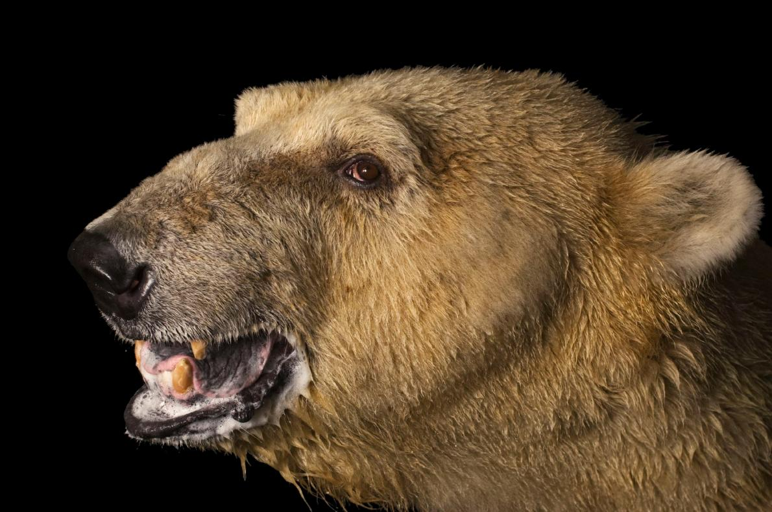
The most carnivorous of the bear species, polar bears feed primarily on the fat of ice-dependent seals.
Polar bears feed almost exclusively on ringed seals and bearded seals. They are also known to eat walrus, beluga whale and bowhead whale carcasses, birds eggs, and (rarely) vegetation.
Polar bears travel great distances in search of prey.
The World Conservation Union (IUCN) estimates that there are between 20,000-25,000 polar bears in the world.
Polar bears live in one of the planet's coldest environments and depend on a thick coat of insulated fur, which covers a warming layer of fat. Fur even grows on the bottom of their paws, which protects against cold surfaces and provides a good grip on ice. The bear's stark white coat provides camouflage in surrounding snow and ice. But under their fur, polar bears have black skin—the better to soak in the sun's warming rays.
Polar bears are the first large species to have
been directly affected by global warming
Joel Sartore, National Geographic

Slide 12
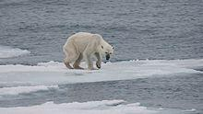
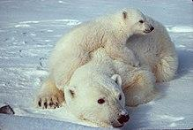
Polar bear threats
The key danger posed by climate change is malnutrition or starvation due to habitat loss.
Polar bears hunt seals from a platform of sea ice. Rising temperatures cause the sea ice to melt earlier in the year, driving the bears to shore before they have built sufficient fat reserves to survive the period of scarce food in the late summer and early fall.
Reduction in sea ice cover also forces bears to swim longer distances, which further depletes their energy stores and occasionally leads to drowning.
Thinner sea ice tends to deform more easily, which appears to make it more difficult for polar bears to access seals. Insufficient nourishment leads to lower reproductive rates in adult females and lower survival rates in cubs and juvenile bears, in addition to poorer body condition in bears of all ages.
Mothers and cubs have high nutritional requirements, which are not met if the seal-hunting season is too short.
In addition to creating nutritional stress, a warming climate is expected to affects vvarious other aspects of polar bear life: Changes in sea ice affect the ability of pregnant females to build suitable maternity dens. As the distance increases between the pack ice and the coast, females must swim longer distances to reach favored denning areas on land.

Slide 13
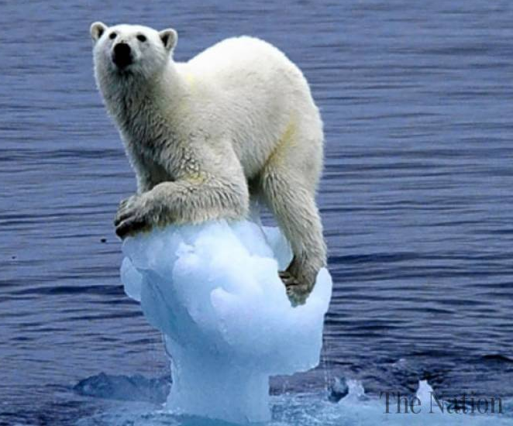
Thawing of permafrost would affect the bears who traditionally den underground, and warm winters could result in den roofs collapsing or having reduced insulate value. For the polar bears that currently den on multi-year ice, increased ice mobility may result in longer distances for mothers and young cubs to walk when they return to seal-hunting areas in the spring.
Disease-causing bacteria and parasites would flourish more readily in a warmer climate.
Problematic interactions between polar bears and humans, such as foraging by bears in garbage dumps have historically been more prevalent in years when ice-floe breakup occurred early and local polar bears were relatively thin. Increased human-bear interactions, including fatal attacks on humans, are likely to increase as the sea ice shrinks and hungry bears try to find food on land.
The effects of climate change are most profound in the southern part of the polar bear's range, and this is indeed where significant degradation of local populations has been observed. The Western Hudson Bay subpopulation, in a southern part of the range, also happens to be one of the best-studied polar bear subpopulations. This subpopulation feeds heavily on ringed seals in late spring, when newly weaned and easily hunted seal pups are abundant.The late spring hunting season ends for polar bears when the ice begins to melt and break up, and they fast or eat little during the summer until the sea freezes again.

Slide 14
The effects of climate change are most profound in the southern part of the polar bear's range, and this is indeed where significant degradation of local populations has been observed.
The Western Hudson Bay subpopulation, in a southern part of the range, also happens to be one of the best-studied polar bear subpopulations. This subpopulation feeds heavily on ringed seals in late spring, when newly weaned and easily hunted seal pups are abundant.
The late spring hunting season ends for polar bears when the ice begins to melt and break up, and they fast or eat little during the summer until the sea freezes again.
This loss of sea ice causes impacts across the Arctic environment, particularly to the marine associated organisms. A typical change seen across all areas of the Arctic is the late freezing and early breakup of the annual first year ice. This increases the occurrence of thin ice and changes the location of the ice edges, which can seriously disrupt the hunting and feeding capabilities of many species.
But there are also other problems…

Slide 15
Cannibalism
Why do polar bears kill their own?
They're hungry. And that hunger may have something to do with diminishing ice masses in the arctic. Scientists say shrinking sea ice may be forcing some polar bears into cannibalizing young cubs and even adult females.
As "the area of sea ice that polar bears can use for hunting declines, progressively fewer seals are accessible to the bears." And "therefore the bears' hunting success likely decline as well."
REUTERS/Iain Williams
"When (bears) are very hungry, they go looking for something to eat," biologist Ian Stirling said Friday. "There's nothing much to eat along the Hudson Bay coast in the fall other than other bears."
REF: http://theweek.com/articles/479523/climate-change-forcing-polar-bears-become-cannibals
https://www.thestar.com/news/2009/11/27/polar_bears_eating_young_due_to_shrinking_sea_ice_scientists.html
https://news.nationalgeographic.com/2016/02/160223-polar-bears-arctic-cannibals-animals-science/

Slide 16
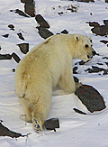
Grizzly and polar bears are the most closely related of the living bear species. The two species are close enough that the hybrid theoretically could have successfully mated with either a polar bear or a grizzly. The warming Arctic environment is causing some animals to shift their range northward. It’s possible, that grizzly bears and polar bears may have more offspring-producing encounters in the future.
As the polar bears’ sea ice habitat continues to shrink as the world warms, the bears may be forced increasingly onto land, where interbreeding with northward-migrating grizzlies could occur.
Should rapid warming continue, the only polar bears left in the Arctic by the mid- to late-21st century could be somewhere in the Ellesmere Island/northern Greenland region, which is about as far from grizzly bear country as one can get in the Arctic.
Polar bear experts said it is possible that the grizzly bears are leaving from the Arctic mainland and traveling roughly 400 miles north, crossing the sea ice as they pursue a caribou herd that annually migrates over the sea ice to Victoria Island. Unable to get back because of rapidly melting ice, some of these grizzly bears have evidently managed to adapt to life in the polar bear’s world, eating seals, hibernating and mating with polar bears.
Hybridization
REF://e360.yale.edu/features/unusual_number_of_grizzly_and__hybrid_bears_spotted_in_high_arctic, Ed Struzik July 27, 2012

Slide 17
Polar bears in Canada
Canada has 13 of the world's 19 bear populations, which amounts to somewhere between 12,000 and 16,000 animals.
The International Union for the Conservation of Nature, one of the world's largest environmental science networks, considers eight bear populations to be in decline. Three populations are considered stable and one is increasing.
Information on seven populations is still too scarce for scientists to draw solid conclusions.
Sadly, Canada is still the only Polar bear range country that hasn’t ban the trophy hunting of this species.
The Polar Bear has become a symbol of Climate Change and struggle for survival for many people. We all know polar ice is melting.

Slide 18
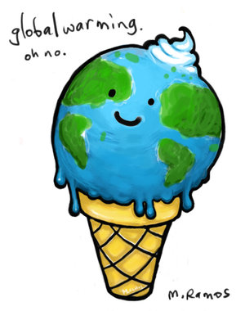
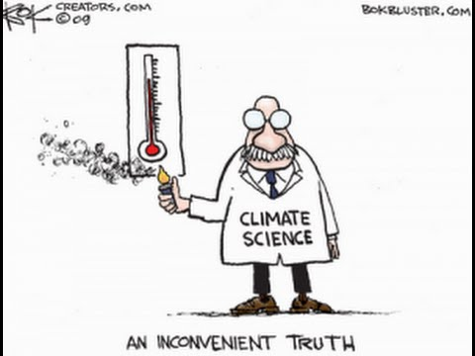
PART II
Understanding climate change,
global warming and its causes

Slide 19
Human activities are the primary cause of the global warming of the past 50 years. The burning of coal, oil, and gas, and clearing of forests have increased the concentration of carbon dioxide in the atmosphere by more than 40% since the Industrial Revolution, and it has been known for almost two centuries that this carbon dioxide traps heat.
Ref:Global Warming By Charlotte Bootherstone

Slide 20
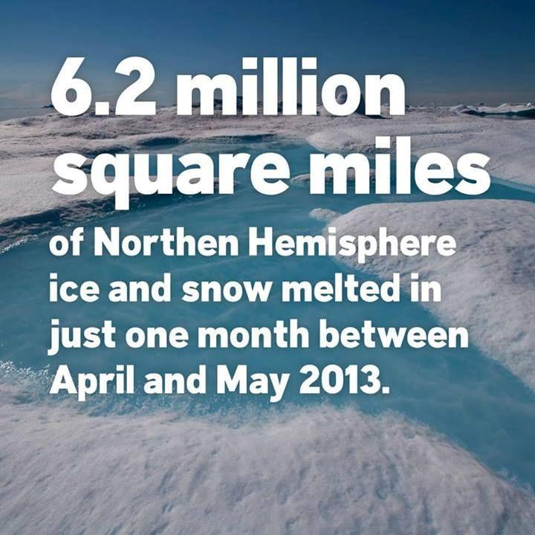
Ref:Global Warming By Charlotte Bootherstone

Slide 21
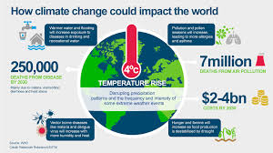
What is climate change?
Climate change happens by global warming. It is important to understand greenhouse effects to better understand about global warming.
Greenhouse effect is the rise in temperatures caused by absorption of the Sun’s heat and light by the Earth’s surface. Greenhouse gases keep the Earth warm. This can be caused by burning fossil fuels such as coal, gas and oil. Its impact becomes stronger and stronger each day.
Climate change is caused by all of us, so we must try to solve it before the reactions for our actions are beyond solution, and we all pay for that.

Slide 22
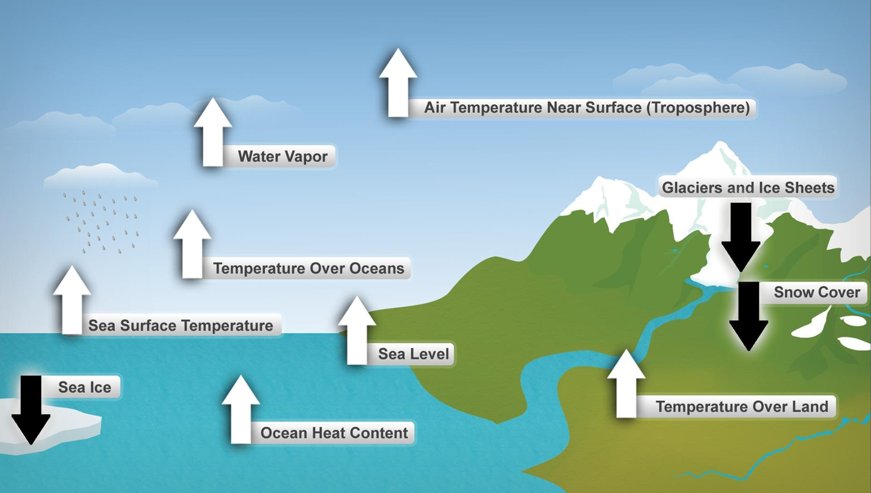
REF: http://nca2014.globalchange.gov/highlights/overview/overview

Slide 23
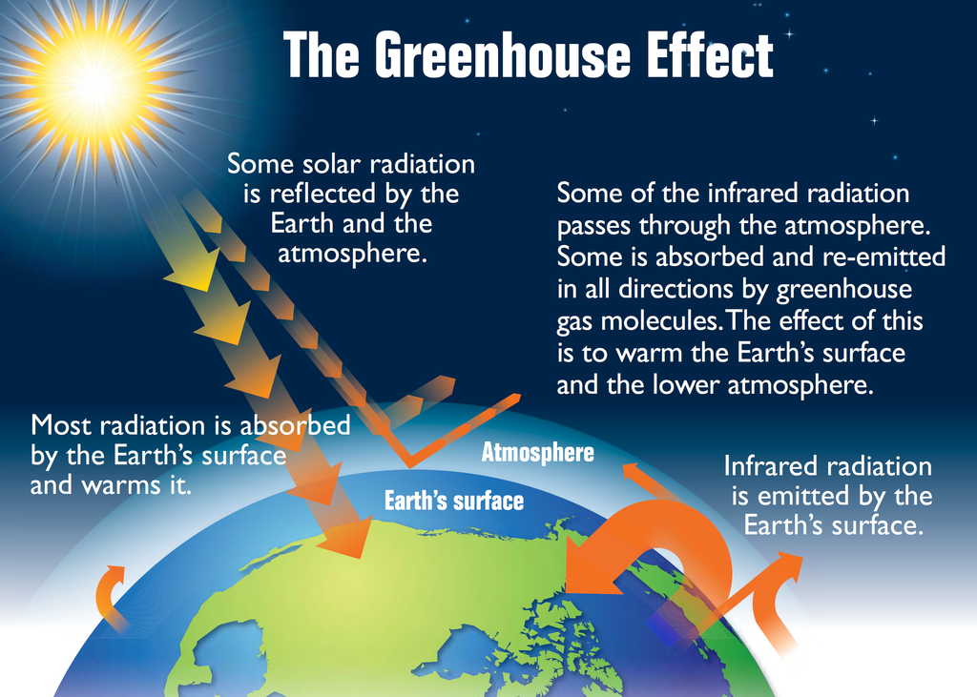
https://commons.wikimedia.org/wiki/File:Earth%27s_greenhouse_effect_(US_EPA,_2012).png

Slide 24
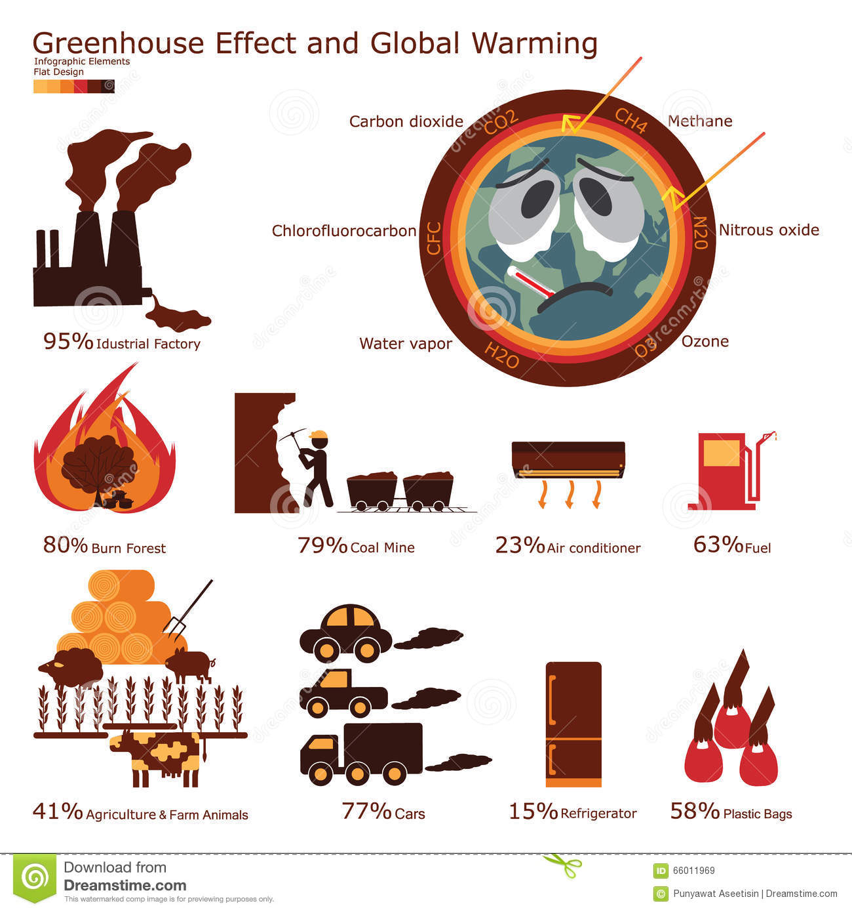
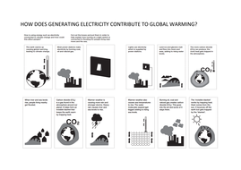
Did you know?
Ruminants including cattle and deer produce large amounts of methane, a greenhouse gas with an impact on the atmosphere 23 times greater than that of carbon dioxide. The production of methane by this process is called enteric fermentation, and it accounts for more than a quarter of methane emissions in the United States.
https://www.livescience.com/52680-the-role-of-animal-farts-in-global-warming-infographic.html https://www.dreamstime.com/stock-illustration-greenhouse-effect-global-warming-infographic-elements-illus-illustration-flat-design-image66011969

Slide 25
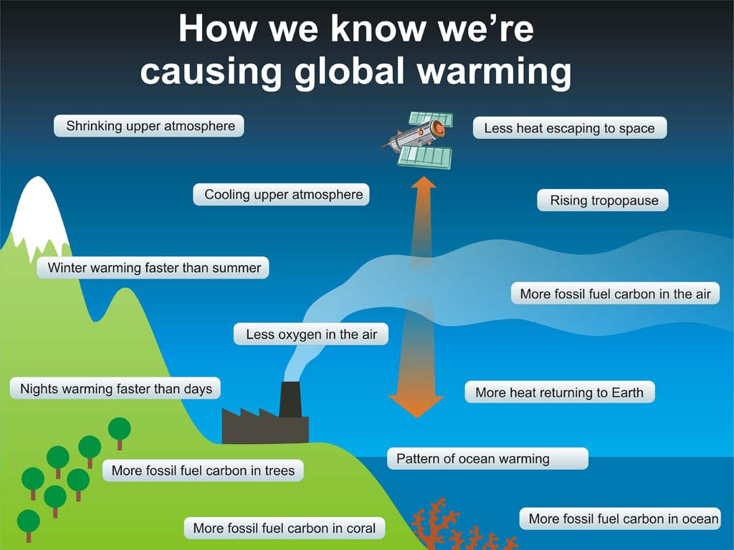
Consequences
REF: https://www.fs.fed.us/rm/boise/research/techtrans/projects/scienceforkids/climatechange
https://mettahu.files.wordpress.com/2013/12/global_warming_infographic.jpg

Slide 26
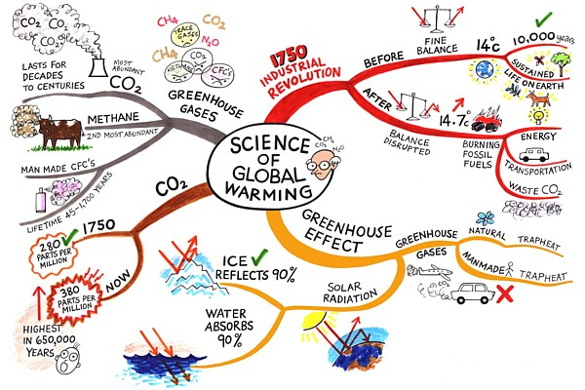
References: *2014 Living World Report by the London Zoological Society and the WWF **http://www.exposingtruth.com/52-drop-animal-populations-40-years/: Effects of global warming essaywww.drobnyreality.sk
Taken together, we are collectively over-extending our resource use far beyond what the planet has to offer. We have been in a “bio capacity deficit” for more than the last 30 years, and we have lost 52% of all wild animals being measured since 1970. *
We are heating the planet at an increasing rate while also increasingly destroying natural ecosystems for financial gain: we have pushed the extinction rate to about 1000x its natural background level. **
* The fact remains that the biggest slice of our ecological footprint comes in the form of carbon emissions. Although issues like deforestation remain important, no single area has increased quite as fast or as drastically as carbon emissions.

Slide 27
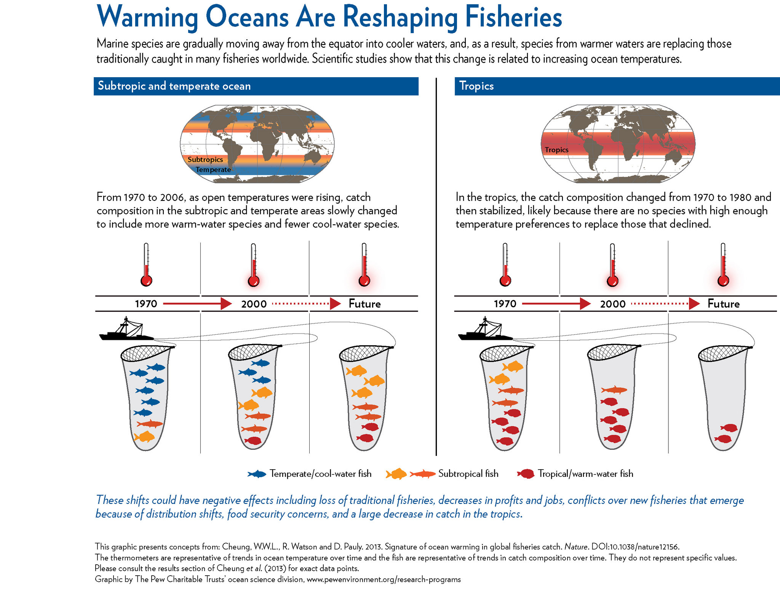
How the fisheries get affected…
As the oceans warm up -- and they have -- fish are moving to cooler places. The newest study on the impact of climate change on global fisheries by University of British Columbia researchers documented fish moving toward the poles and to deeper waters.
http://www.oregonlive.com/environment/index.ssf/2013/05/fish_moving_toward_cooler_wate.html

Slide 28
Weather
The weather is affected the most by climate change. Therefore, we are already witnessing big changes in our usual weather conditions.
This is affecting the whole planet and it is just going to get worse…

Slide 29
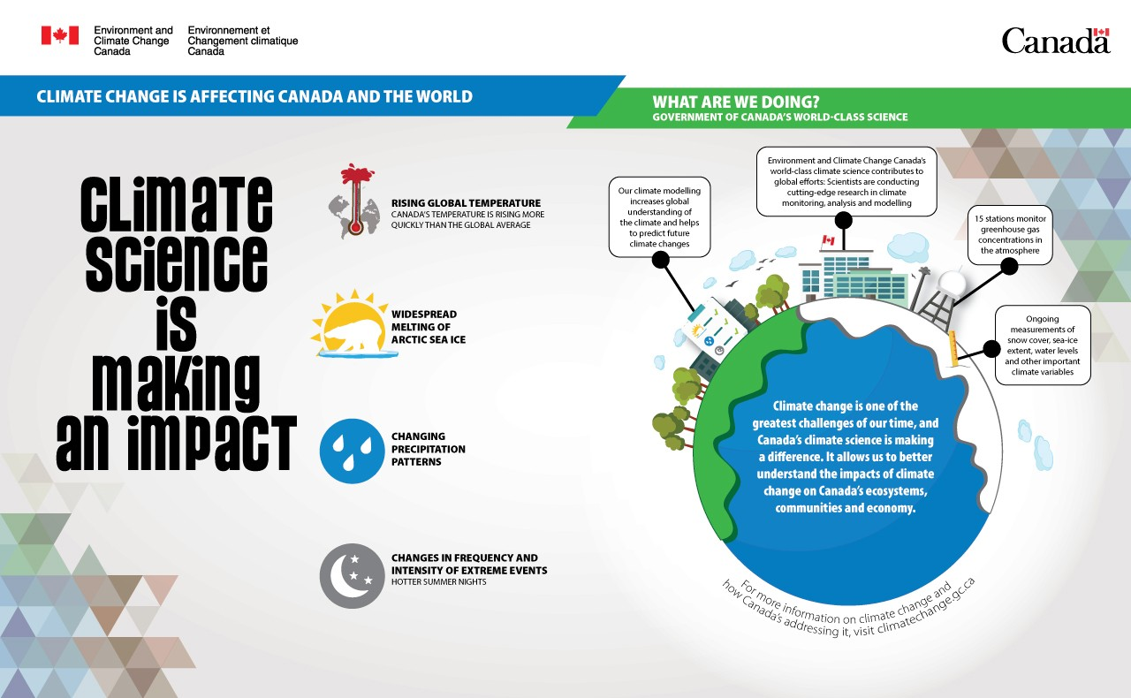
RE: https://www.canada.ca/content/canadasite/en/environment-climate-change/services/climate-c

Slide 30
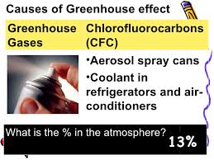
Examples: coffee cups, hair spray, deodorant spray, paint spray….

Slide 31
Main Causes Energy Types

Slide 32
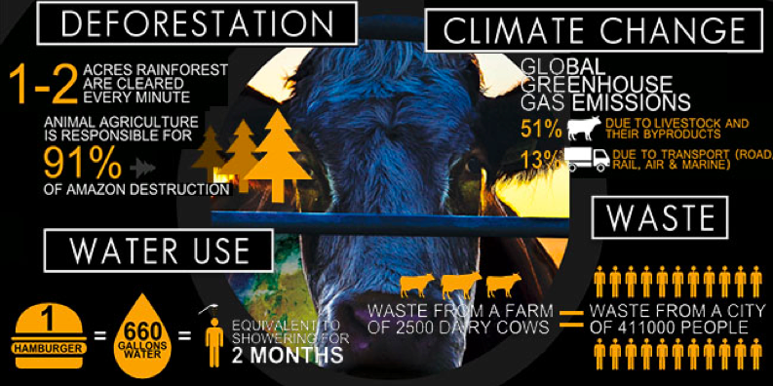
RE: Cowspiracy

Slide 33
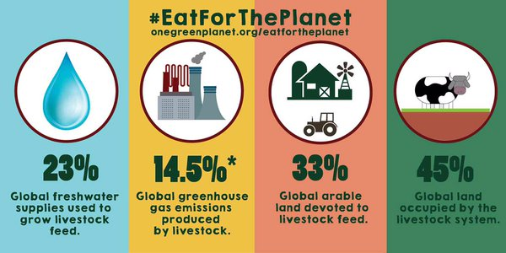
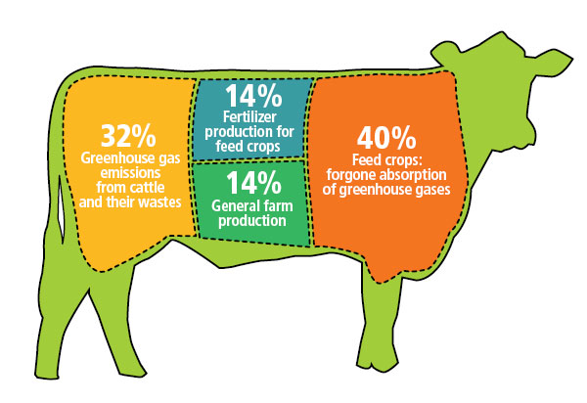
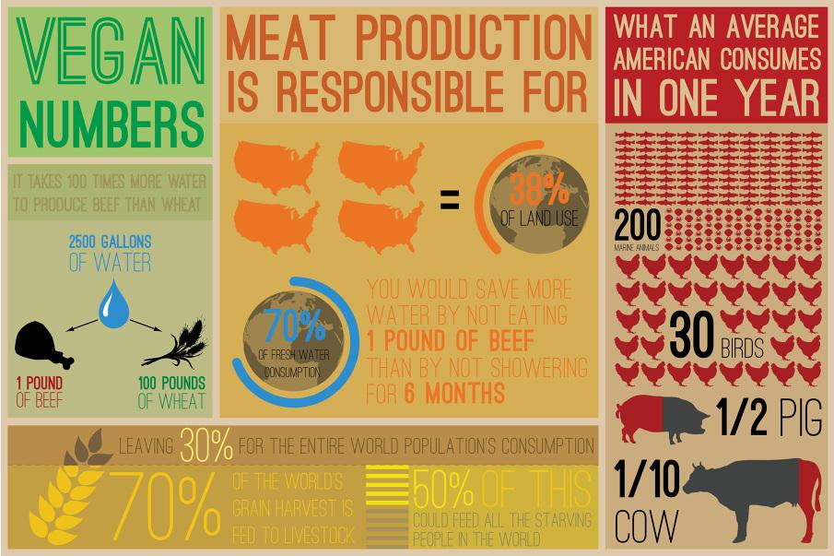
How the farm factories
affect our planet
#EarthDay https://t.co/CEuUUwcrn5 http://cargocollective.com/Anyafromsiberia/Vegan-infographic

Slide 34
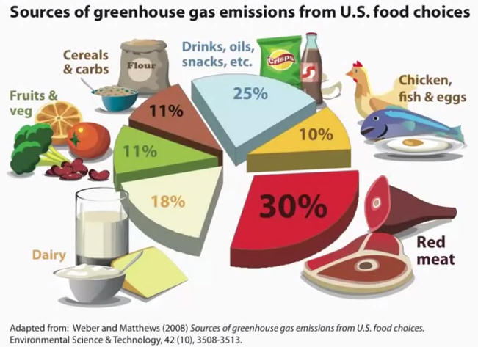
Your food affects the planet

Slide 35
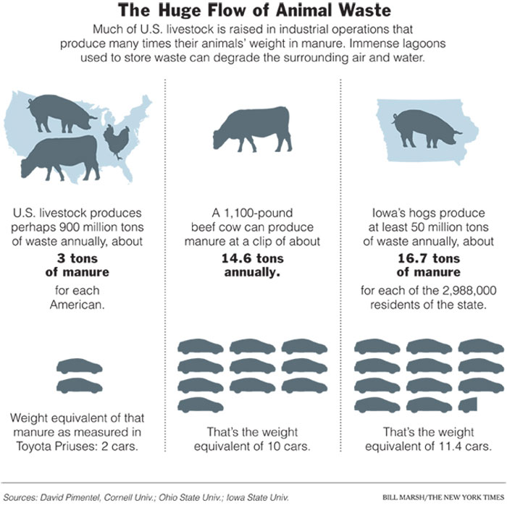
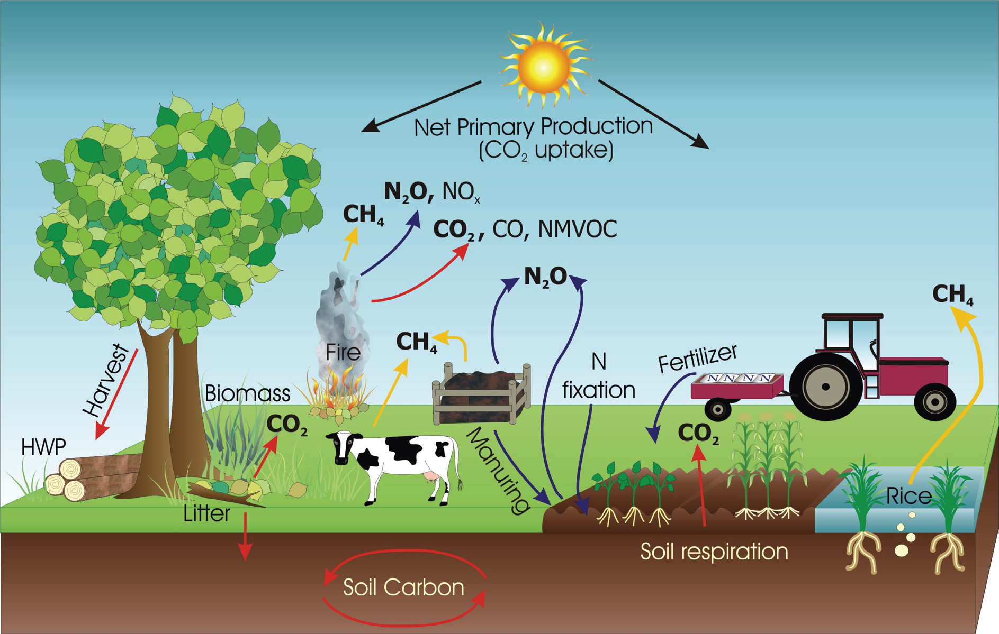
What share of global greenhouse gas emissions comes from agriculture?
Farms emitted 6 billion tonnes of GHGs in 2011, or about 13 percent of total global emissions. That makes the agricultural sector the world’s second-largest emitter, after the energy sector (which includes emissions from power generation and transport).
https://mettahu.files.wordpress.com/2013/12/global_warming_infographic.jpg

Slide 36
It’s true that shortening our showers and turning off the sink while brushing our teeth are good ways to save water, but 34-76 trillion gallons of water are used annually for an unsustainable purpose that often goes unacknowledged, and therefore unchallenged. Those trillions of gallons of water are used by the animal agriculture industry. Compare that to only 70-140 billion gallons used by hydraulic fracturing, or the process of retrieving our drinking water. The water ban conversation has left out a significant way to lessen our water footprint. For example, the fact that showering for five minutes uses 12 gallons of water is posted outside of most showers in dorms, but it goes unmentioned that 660 gallons of water are used to make one burger. That’s like 32 showers worth of water compiled into one item.
Producing meat takes an excessive amount of fresh water; that is, 2,500 gallons per pound of beef. That’s an astonishing amount of water for such small product outcome. Although the other methods of saving water, including less frequent toilet flushing, shorter showers, and turning the sink off, are all helpful, food production makes a much more significant impact on our water use. Compare the 55 percent of water consumed in the United States for animal agriculture, to the 5 percent consumed by private homes. Animal agriculture is responsible for 20-33 percent of all fresh water consumption in the world today. This should be very alarming in that water shortages are very common, and water scarcity affects over 2.7 billion people for at least one month each year. You may be wondering how and why this much water is used in the process of producing these animal products. The more processed your food is usually means the more water used to get to your plate. Livestock feed, such as grains and corn, require high levels of water in their production. The animals themselves require water for drinking, and processing the meat products also uses water. All of that water could be going to much more sustainable sources that produce greater product outcomes with much less water waste.

Slide 37
https://www.hercampus.com/school/u-mass-amherst/way-save-water-no-one-talks-about-0
For example, per pound, potatoes require 60-180 gallons of water, rice 228-600 gallons, and soybeans 132-240 gallons. In addition, the amount needed to produce one pound of lettuce, wheat or tomatoes is 25 gallons or less. These products require a lot less water to be produced than animal products, and can be produced in greater quantities for lesser costs of water, as well as many other factors like carbon dioxide and land use. If there wasn’t already enough of an urgency for change, eating animals isn’t just draining our water supply. Today animal agriculture is the leading cause of species extinction, ocean dead zones, water pollution, and habitat destruction. You might be wondering what you can do to help. Reducing your meat consumption can have a significant impact, and one person really does make a difference. For example, someone who follows a veg diet produces the equivalent of 50 percent less carbon dioxide, and uses 1/11 of oil, 1/13 of water, and 1/18 of land compared to someone who follows an omnivore diet. A 2009 study found that an omnivorous diet uses 2.9 times more water, 2.5 times more energy, 13 times more fertilizer, and 1.4 times more pesticide than a vegetarian diet. There are many factors at stake when it comes to the daily food decisions we make and the companies we are giving our money to. Let us be educated and choose wisely.

Slide 38
Where do a farm’s emissions come from?
Most farm-related emissions come in the form of methane (CH4) and nitrous oxide (N2O). Cattle belching (CH4) and the addition of natural or synthetic fertilizers and wastes to soils (N2O) represent the largest sources, making up 65 percent of agricultural emissions globally. Smaller sources include manure management, rice cultivation, field burning of crop residues, and fuel use on farms. At the farm level, the relative size of different sources will vary widely depending on the type of products grown, farming practices employed, and natural factors such as weather, topography, and hydrology.
Which countries produce the most agricultural emissions?
The 10 countries with the largest agricultural emissions in 2011 were (in descending order):
China, Brazil, United States, India, Indonesia, Russian Federation, Democratic Republic of Congo, Argentina, Myanmar, and Pakistan.
Together, these countries contributed 51 percent of global agricultural emissions.

Slide 39
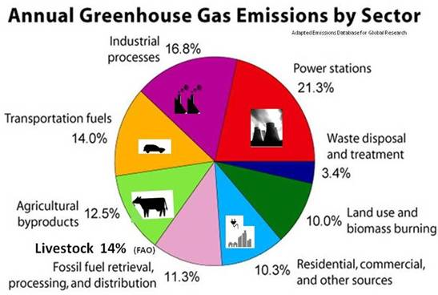

Slide 40
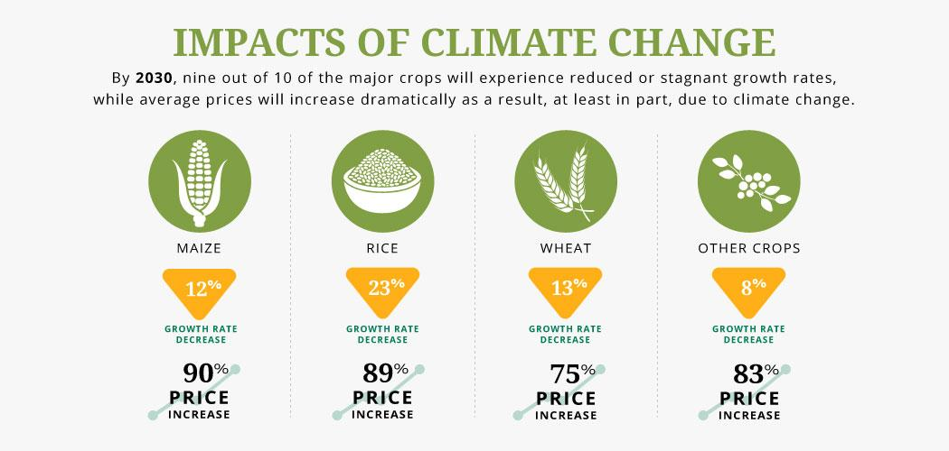
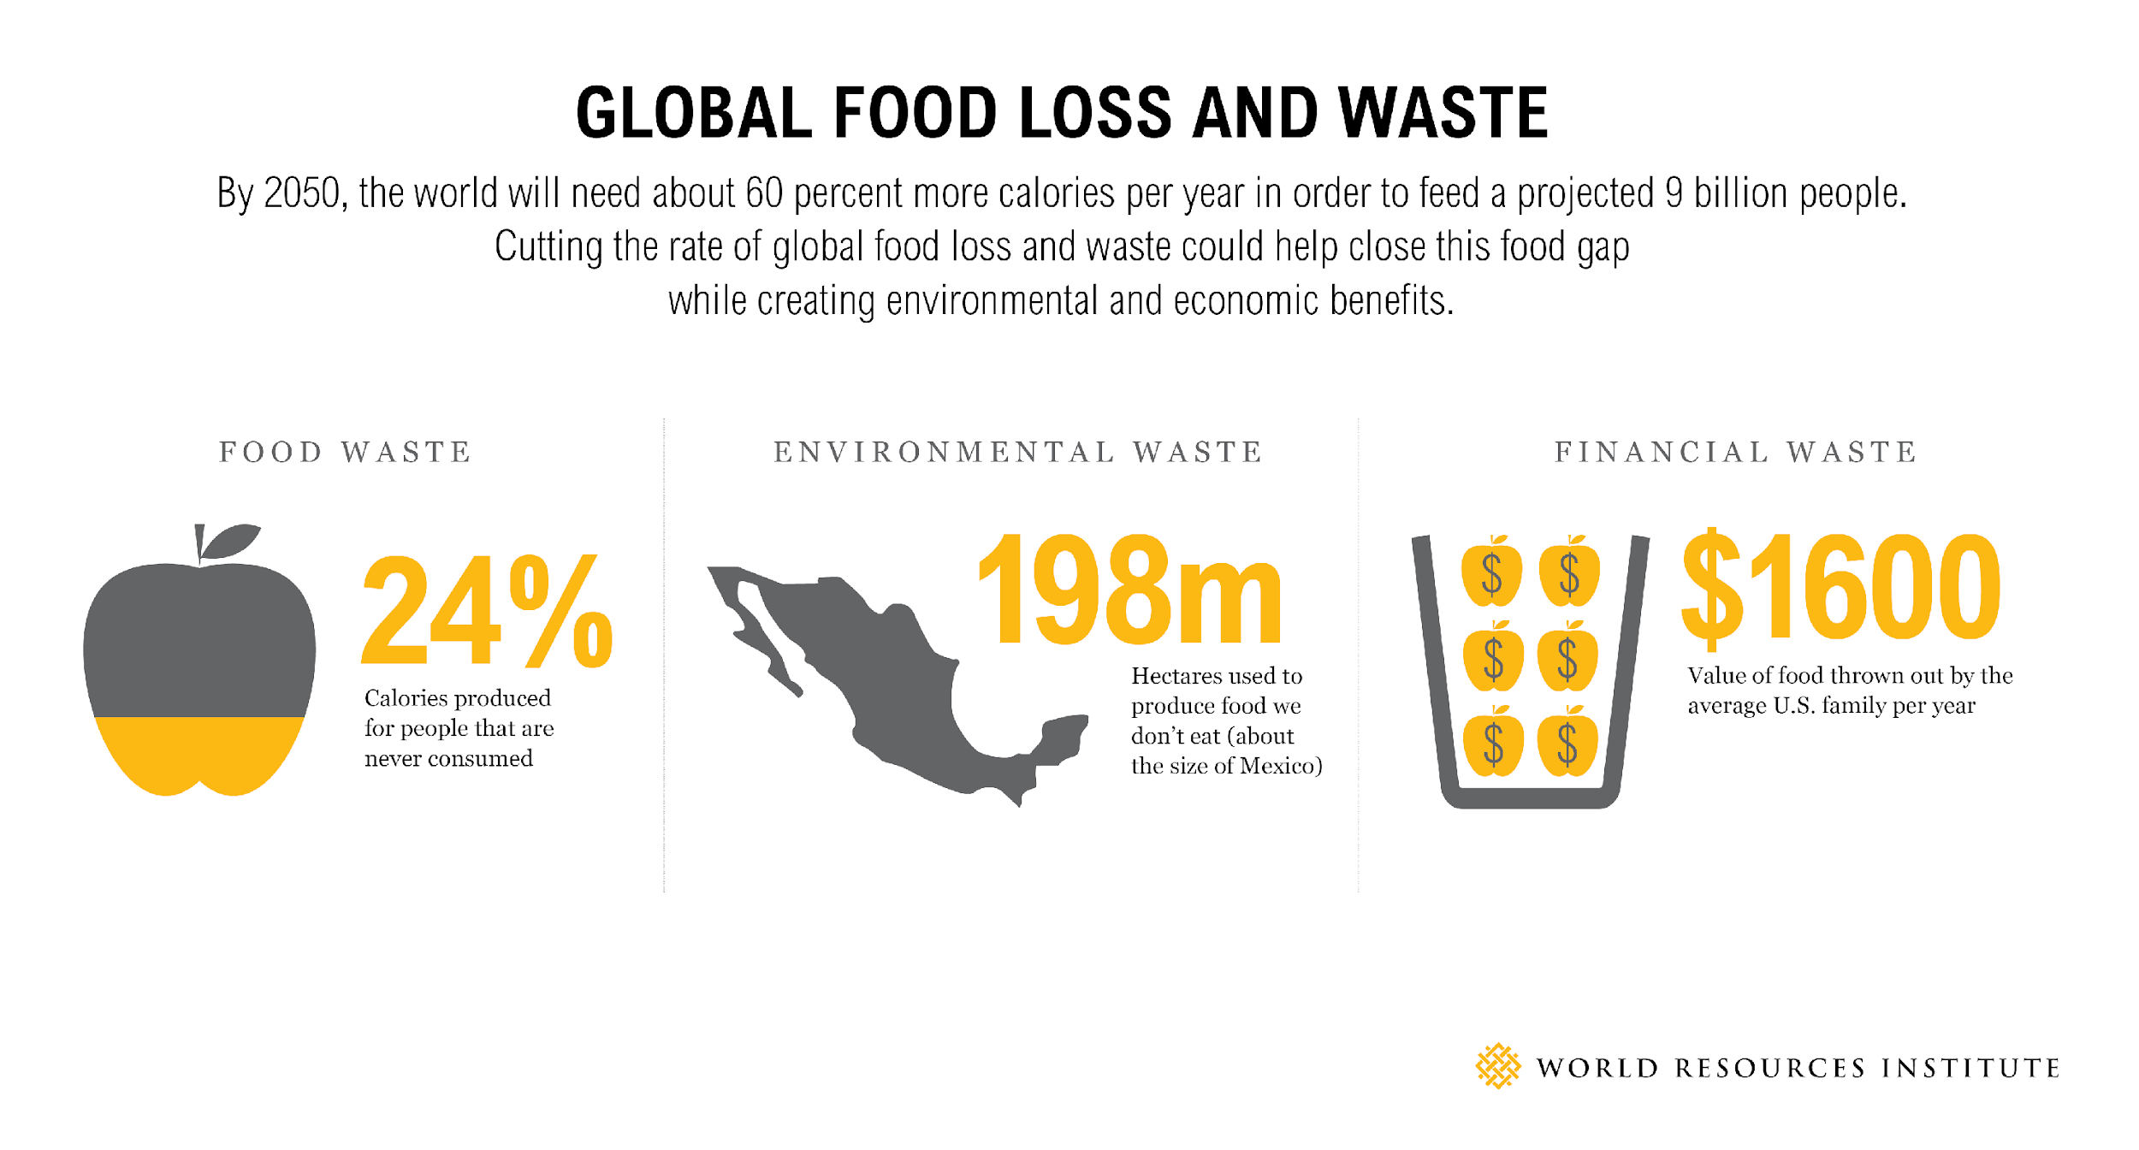
Some other interesting facts
https://farmingfirst.org/sdg-toolkit
http://www.wri.org/blog/2014/05/everything-you-need-know-about-agricultural-emissions

Slide 41
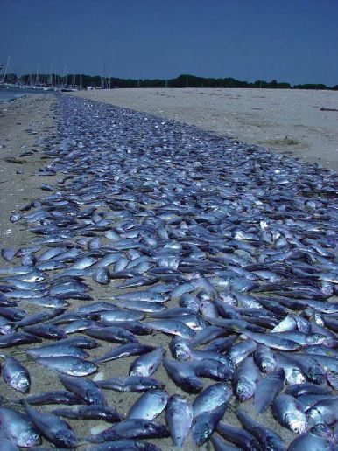
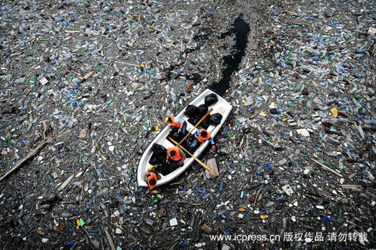
How this affects other animals
Pollution
Pollution comes in all shapes and sizes. From your empty plastic water bottle, to paper bags, plastic bags, soft drink and beer can ring yokes, napkins, candy wraps, empty plastic containers, aluminum cans, etc.
All animals are affected by climate change as a consequence of global warming. Pollution in the air, land and oceans is decimating millions of animals word wide every year, who are unable to cope with acid rain, plastic, deforestation, etc.

Slide 42
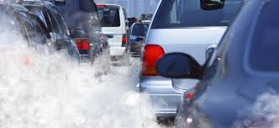
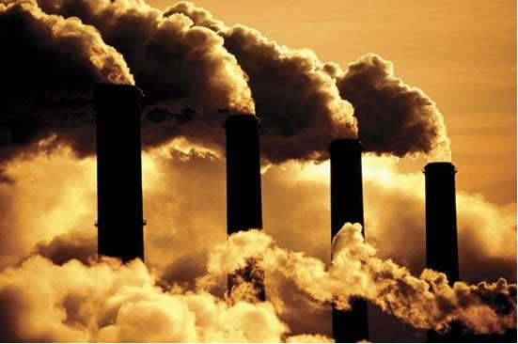
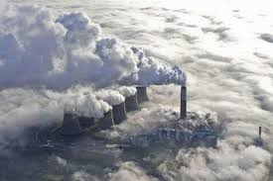

Slide 43
Everyday Solutions
Carpool or use public transportation | Recycle, Recycle, Recycle
Switch to Energy efficient light bulbs and appliances | Don't waste! Instead of throwing things out, fix it or use it for something else. If you can, buy things that are less likely to break or become unusual.
Turn off lights and devices when you're not using them. | Instead of using plastic or paper bags at the grocery store, invest in some reusable bags!
Instead of driving to close destinations, ride your bike, walk or take the bus. | Avoid buying bottled water, invest in a water filtration product, which will save you money in the long run!
Plant trees to absorb greenhouse gases | Ask about installing solar energy panels on your home!
Eat locally grown foods! Instead of eating foods that used a ton of energy and fuel to ship them across the country or even the world, eat foods grown near you! This also helps your local economy! | Educate yourself! This is probably one of the most important things that you can do! Learn as much as you can and share your knowledge with others!
http://nc93fo113c.cf/dyhum/homework-help-social-issues-global-warming-jije.php

Slide 44
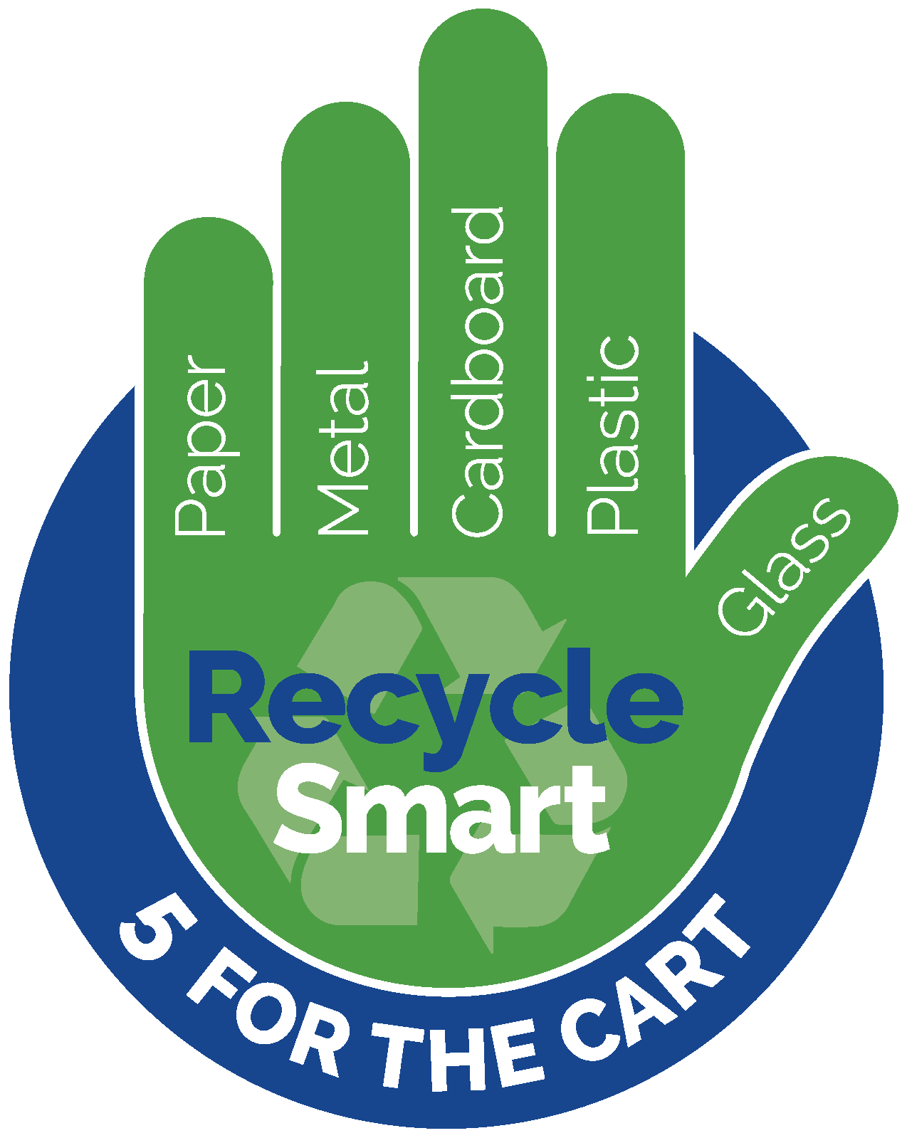
Recycle whatever you can and choose things made from recycled materials. Recycling is the most important things to prevent global warming problems. Recycling helps to : Save energy, save land space, save money, create new jobs, reducing air and water pollution and preserving habitat for wildlife. That’s why recycling is important and you should take a closer look at your life and how you recycle materials used in your daily life. It takes less energy to process recycled materials. For example, it takes less energy to recycle paper from waste material than it does to create paper from new woodland, because there is no longer a need to cut down a new tree, process the wood from the tree and make it into paper. Remember reduce, reuse, recycle!

Slide 45
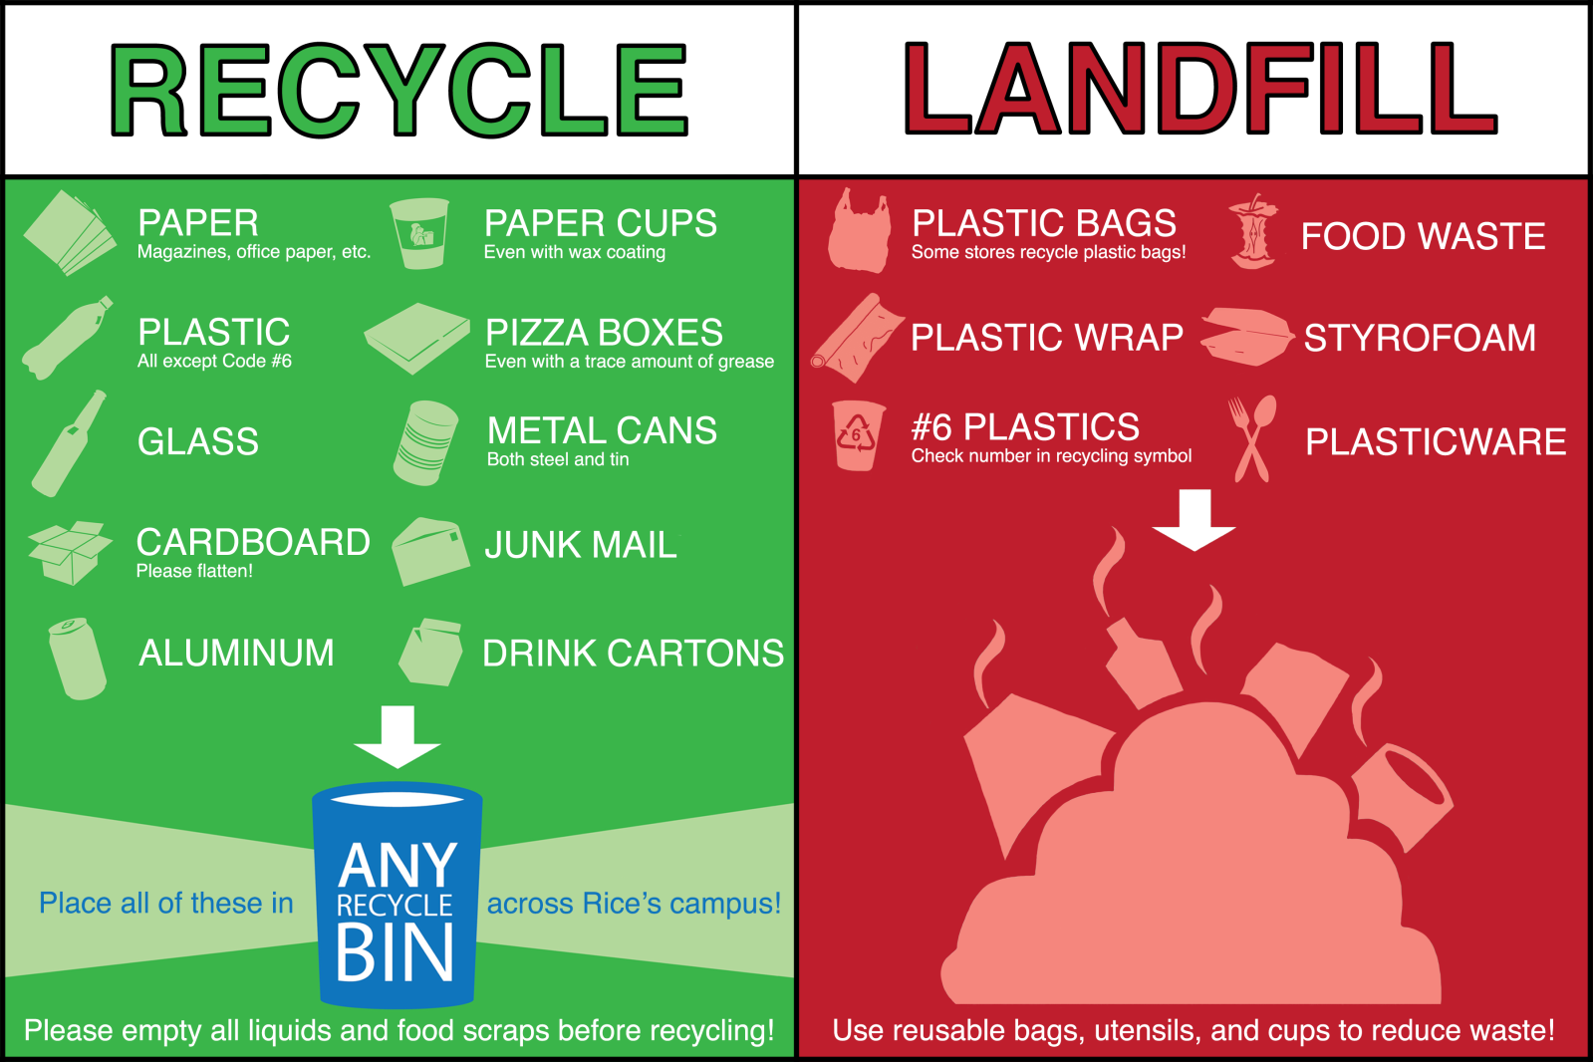
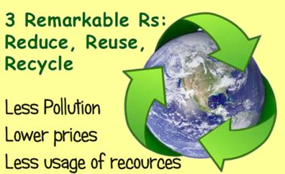

Slide 46
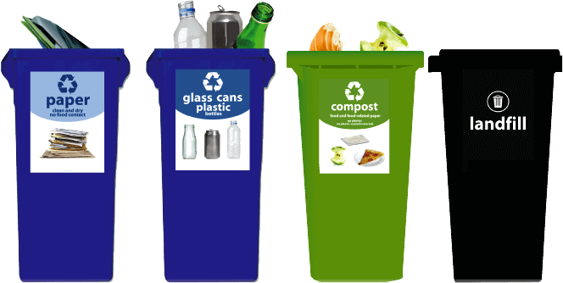
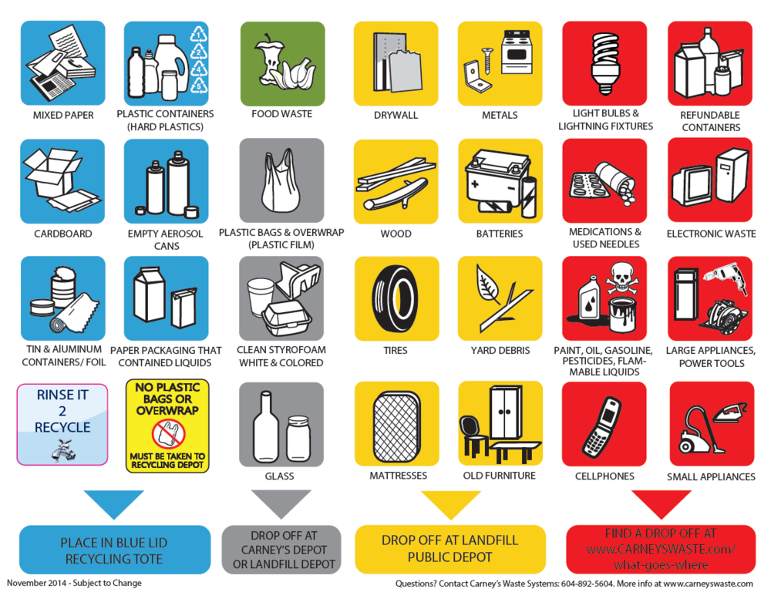
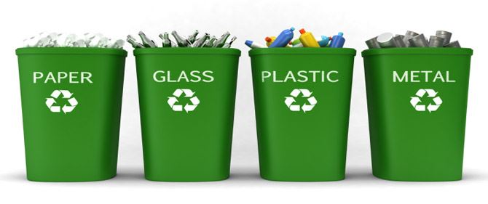
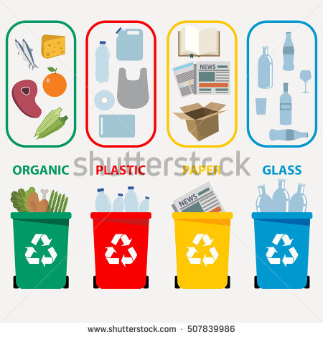

Slide 47
What are the biggest opportunities
to reduce agricultural emissions?
Changes in both farming practices and food demand offer big opportunities. On the supply side, crop management practices—such as improved fertilizer management and conservation tillage—offer the greatest reduction potential at relatively low costs. Better managing grazing lands—such as by rotational grazing and altering forage composition—and restoring degraded lands and cultivated organic soils into productivity are also important.
On the supply-side, shifting away from meat and particularly beef consumption offers the most potential for reducing emissions. Also, recent WRI research shows that about 24 percent of all calories currently produced for human consumption are lost or wasted in the food supply chain. Consequently, reducing food losses and wastes can also play an important role.

Slide 48
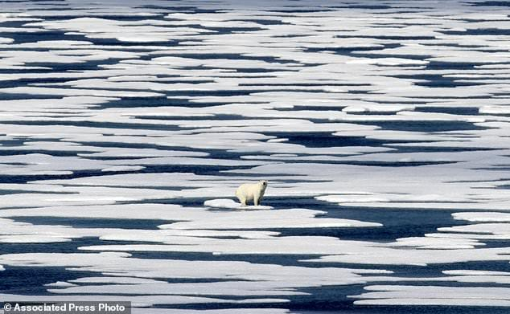
Conclusions
This beautiful planet is our home and home to other millions of living beings. If we continue to disregard global warming and we do not take urgent action in our daily routines and habits, we all are going to suffer of the deadly consequences.
The Arctic will continue to shrink and the Polar bears will go extinct if we do not modify our ways ASAP, we all will cause their annihilation.
WE ALL CAN DO OUR SHARE TO SAVE OUR PLANET EARTH!

Slide 49
Recommended Videos
NASA | Arctic Melt Season Lengthening, Ocean Rapidly Warming
https://www.youtube.com/watch?v=7IQBn-Sg-gc
Arctic Sea Ice Extent Is Eighth Lowest on Record NASA Live Earth From Space https://www.youtube.com/watch?v=3BkLPK9q6f4
How Will Earth Change If All the Ice Melts?- An inconvenience Sequel DOC https://www.youtube.com/watch?v=pIxRVfCpA64
Global Warming 101 | National Geographic
https://www.youtube.com/watch?time_continue=13&v=oJAbATJCugs
PB NG https://www.nationalgeographic.com/animals/mammals/p/polar-bear/
video.nationalgeographic.com/video/101-videos/polar-bears-101

Slide 50
THANK YOU for caring! 谢谢

